Slide 1
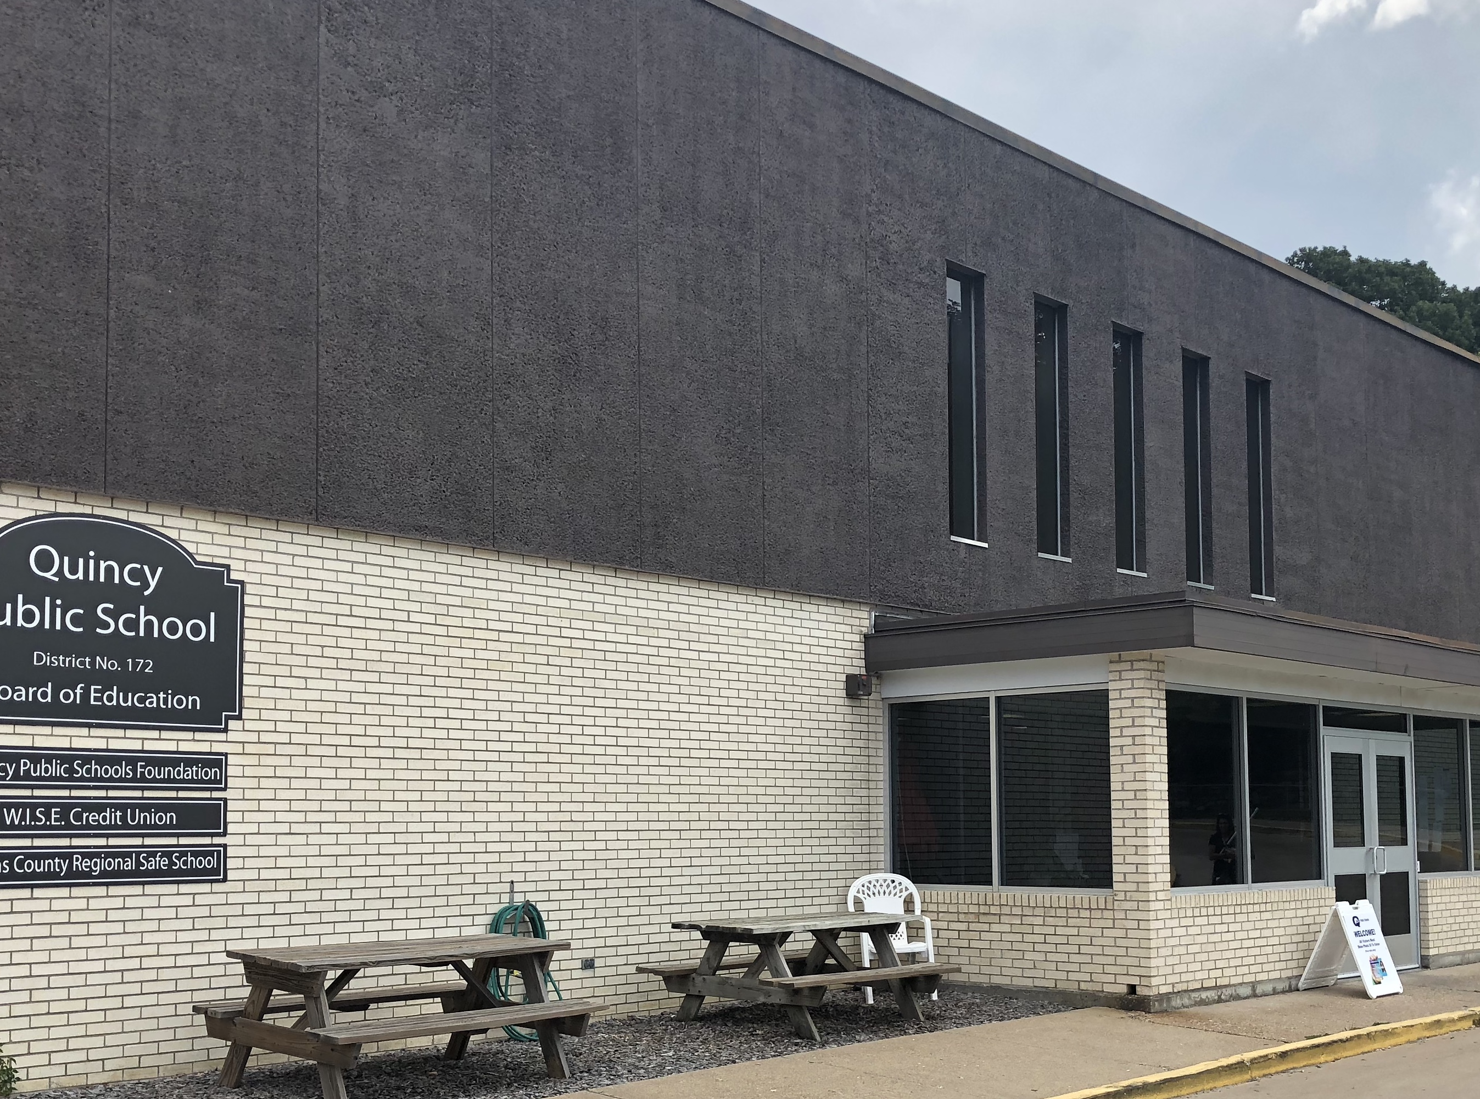
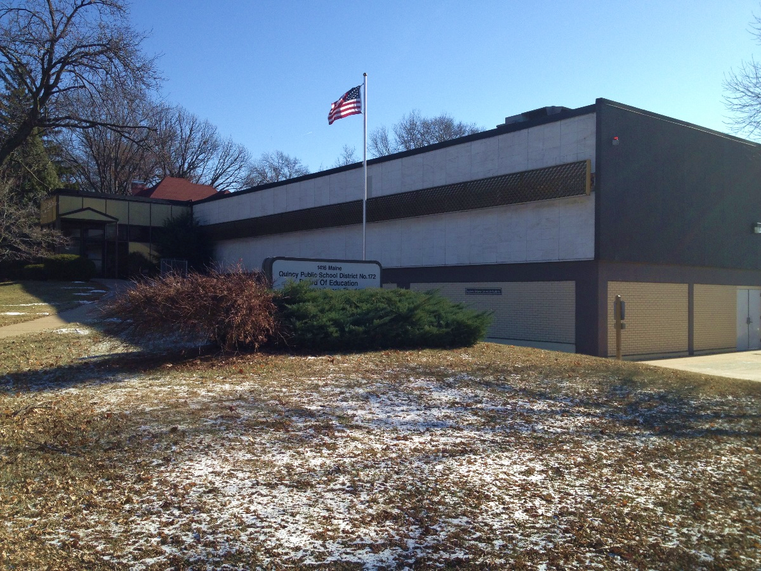
SCHOOL improvement plan
ABC/ ACRSS June 2019

Slide 2
situation
The Academic Behavior Community Academy and Adams County Regional Safe School consolidated leadership and Professional Learning Communities in 18-19.
Students must meet RSSP (Regional Safe School Program) criteria ( 1. be suspended for 4-10 days twice for gross misconduct 2. arrested by the police and/or remanded to criminal or juvenile courts 3. involved in misconduct that can be demonstrated as serious, repetitive and/or cumulative, 4. previously remediated at least once by the home school/district ) and be either suspension or expulsion eligible to receive services.
ABC/ACRSS provide services to students in grades 7-12 from Quincy, Payson, Camp Point, Liberty, and Mendon.
The programs employ ten certified staff members, five classified staff members, and two administrators.
The ABC Academy served 38 students for the 18-19 school year.
ACRSS served 75 students for the 18-19 school year.
Offer monthly family dinners for ABC/ACRSS students, families, and staff and their families.

Slide 3
mission
ACRSS MISSION STATEMENT
ABC ACADEMY MISSION STATEMENT
Empower students to become productive members of the community by providing quality learning opportunities in:
Independent life skills
Academic skills
Positive self-concepts
Effective relationships with others
Our mission is to educate and challenge our students to achieve personal excellence by providing opportunities and the support needed to meet their unique educational and social-emotional needs.

Slide 4
strengths
Building relational capacity with students, families, and staff
Providing individualized social emotional interventions for all students
Providing positive acknowledgement for positive student behaviors
Providing restorative justice for students and families
Providing information and outside resource support to students and families
Active partnerships with community agencies and community businesses

Slide 5
Areas to improve
Graduation rate
Overall student attendance
Differentiated academic interventions for all students (general education and special education)
Student performance on MAP, SAT, Delaware, QRI6
Student class completion

Slide 6
goals
The students at the ABC Academy/ACRSS will show growth in the areas of attendance, academics, and behavior. This growth will be measured through quarterly data collection.
Attendance Interventions and Measures-Play 21, ABC/ACRSS Attendance Incentives (weekly, quarterly, semester), and ABC/ACRSS Truancy Plan, Student Attendance Success Plan; will measure weekly, quarterly, semester, and yearly.
Academic Interventions and Measures-Edgenuity, MyPath, Max Scholar, guided reading; will measure MAP scores for 7-10th grade students, SAT, Delaware Writing, QRI-6 (ABC), and senior proficiencies.
Behavior Interventions and Measures-Daily SEL and PBIS lessons, CICO, SAIG groups, restorative justice re-entry meetings, implementation of brief and complex BIP’s; will measure student meets criteria for CICO, BIP’s, Alternate Education Plans, ODR’s, OSS
2. By the end of the 19-20 school year, the ABC Academy and ACRSS will reduce the number of disciplinary referrals 10%, while improving school understanding of the PBIS process
3. By the end of the 19-20 school year, the ABC Academy and ACRSS will reduce the number of Out of School Suspensions by 10%.

Slide 7
Student growth
ABC Academy
ACRSS
22 Student Goals/ 20 of Students Reached Goal- 91%
100% of Teachers SLO met Objectives
ABC Academy Number of Student Referrals for the 17-18 School Year-131 Offenses
ABC Academy Number of Student Referrals for the 18-19 School Year-254 Offenses
ABC Academy Overall Attendance for the 17-18 School Year-54.05%
ABC Academy Overall Attendance for the 18-19 School Year-55%
157 Student Goals/ 129 of Students Reached Goal- 82.1%
100% of Teachers SLO met Objectives
ACRSS Number of Student Referrals for the 17-18 School Year-568
ACRSS Number of Student Referrals for the 18-19 School Year-363
ACRSS Overall Attendance for the 17-18 School Year-71.1%
ACRSS Overall Attendance for the 18-19 School Year-60%

Slide 8
Hot rocks
Revision of commitment statements, school mission, and vision statements for the ABC Academy/ACRSS team
Opening a transitional alternative classroom to provide proactive social emotional services, to facilitate restorative justice re-entry plans, provide short term placement for students struggling to follow expectations, etc.
Providing adequate education, resources, and linkages for post secondary successes

