Slide 1

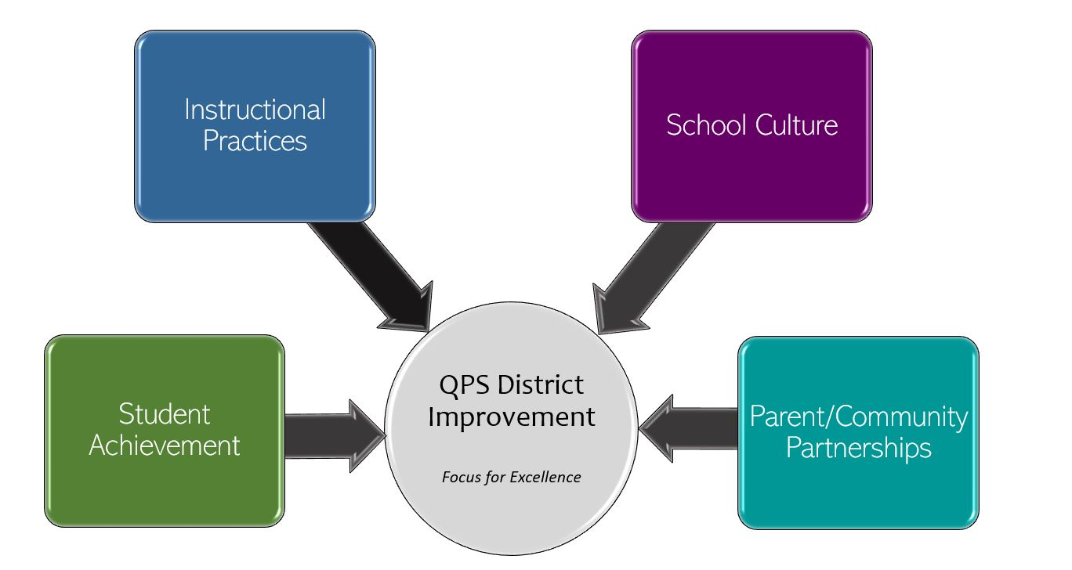
Thomas S. Baldwin School Improvement 2022-2023 Focus for Excellence
Goal 1- Student Achievement | Alignment to District Q Goal 1
Increase overall student achievement and growth across all grade levels and programs Math: Improve students’ math fact fluency, math strategies, and explanation (verbal and written) of math answers. Writing: Improve students’ writing, conventions and purpose. Reading: Improve reading stamina, comprehension, and critical thinking skills. | QPS WILL increase student achievement and growth in grades PK-12. *Evidenced by: State and local assessment data and MTSS intervention data.
Evidenced by: (Data/Monitoring)
Math: MAP scores, grade level math assessments (unit tests, BOY, MOY, EOY, ACI’s, Cumulative reviews) Writing: Writing proficiency (Quarterly) Reading: WAR, F&Ps IEP Progress reports
School Tasks and Staff Professional Development to Support Goal
Math: Reground in Everyday Math through grade level common planning and coaching cycle; Introduce and implement Rocket Math building wide Writing: Cross curricular critical thinking and writing opportunities; Provide PD on use of common language across all grade levels Reading: Provide PD during common planning on building reading stamina, comprehension, and inquiry based and higher order questioning techniques. *Follow IL Learning standards and use of student “I can” statements in math, writing, and reading.

Slide 2
Thomas S. Baldwin School Improvement 2022-2023 Focus for Excellence
Goal 2- Instructional Practices | Alignment to District Q Goal 2
Utilize grade level curriculum maps and best practices to promote student engagement in all settings. | QPS WILL utilize standards-based curriculum maps to ensure a guaranteed and viable curriculum is provided for all students and work in professional learning communities to plan for instruction that promoted critical thinking, collaboration, creativity and engagement. Evidenced by: School culture data, state and local assessment data, instructional practice data
Evidenced by: (Data/Monitoring)
5 Essentials survey data Informal walkthrough data Peer observations
School Tasks and Staff Professional Development to Support Goal
Provide weekly common planning centered around curriculum maps and best practice Provide coaching cycle opportunities for teachers

Slide 3
Thomas S. Baldwin School Improvement 2022-2023 Focus for Excellence
Goal 3- School Culture | Alignment to District Q Goal 3
Increase sense of healthy and supportive environment. | QPS WILL maintain and safe, healthy, supportive and equitable environment for all students and staff. *Evidenced by: School Culture Data, Discipline Data, Teacher Retention data, and MTSS data
Evidenced by: (Data/Monitoring)
5 Essentials Collaborative Teachers (Collaborative Responsibility and School Commitment) School Climate Survey (Quarterly)
School Tasks and Staff Professional Development to Support Goal
Provide opportunities for all staff collaboration and have task teams/committees to assist with team building and shared responsibility. Increase student involvement in building responsibility through student leadership teams

Slide 4
Thomas S. Baldwin School Improvement 2022-2023 Focus for Excellence
Goal 4- Parent/Community Partnerships | Alignment to District Q Goal 4
Strengthen parent support and community engagement by building positive relationships and communication between parents, families, schools, and community. | QPS WILL strengthen parent support and community engagement by building positive relationships and communication between parents, families, schools and community to foster success for all students. Evidenced by: Attendance and truancy data, parent event attendance data, parent survey data, discipline data
Evidenced by: (Data/Monitoring)
5 Essentials Survey Call logs
School Tasks and Staff Professional Development to Support Goal
Partner with PTA to offer events during school day to reach more families. Provide opportunities for teachers to attend PTA meetings during the day Posted calendar of events on school website All classroom teaching staff will contact 100% of their student families via phone call within the first month of school. Bring back schoolwide assemblies for acknowledging student achievement (e.g., Awesome Aviator)

