Slide 1
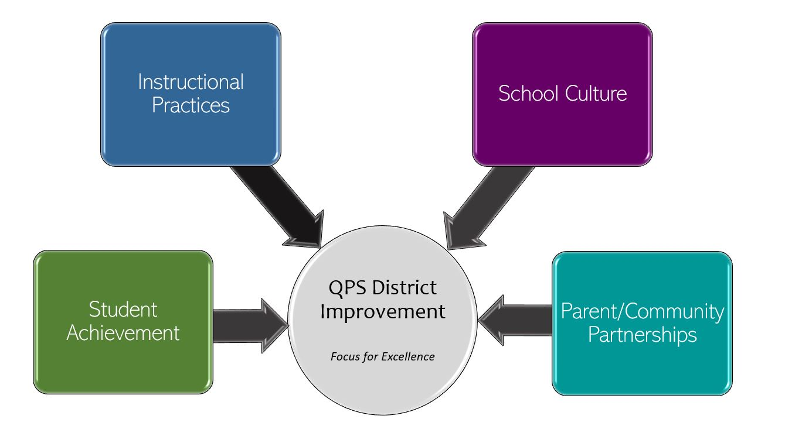
Denman Elementary- School Improvement 2022-2023 Focus for Excellence
Goal 1- Student Achievement | Alignment to District Q Goal 1
Denman Elementary will raise student achievement in Reading from 58% to 62% (students scoring average and above) and raise the percentage of students meeting their projected growth from 52% to 56%. Denman Elementary will raise student achievement in Math from 62% to 66% (students scoring average and above) and raise the percentage of students meeting their projected growth from 57% to 61%. | QPS WILL increase student achievement and growth in grades PK-12. *Evidenced by: State and local assessment data and MTSS intervention data.
Evidenced by: (Data/Monitoring)
NWEA MAP Grade Level Data NWEA MAP Achievement Status and Growth Projection or Summary Monitor Fall, Winter and Spring through data dives with administration, one-on-one, grade level teams, and school-wide for analysis and goal setting District Reading, Writing and Math Proficiencies (Quarterly)
School Tasks and Staff Professional Development to Support Goal
Collaborative Study group on Teaching for Deeper Learning (learning tools to engage students in meaning making). Professional Development on Creating Visible Learning Classrooms (Implementing practices that work best to accelerate student learning).

Slide 2
Denman Elementary- School Improvement 2022-2023 Focus for Excellence
Goal 2- Instructional Practices | Alignment to District Q Goal 2
Denman Elementary teachers will focus on the high-probability practice of Visible Learning for literacy and mathematics to develop understanding of surface learning, deeper learning and teaching for transfer for the greatest impact on student learning. | QPS WILL utilize standards-based curriculum maps to ensure a guaranteed and viable curriculum is provided for all students and work in professional learning communities to plan for instruction that promotes critical thinking, collaboration, creativity and engagement. *Evidenced by: School culture data, state and local assessment data, nstructional practice data
Evidenced by: (Data/Monitoring)
Instructional practice walk-through data (baseline data will be gathered in Fall and Smart goals will be developed) every 12 weeks. Peer Observations of Visible Learning, one observation per semester by each teacher.
School Tasks and Staff Professional Development to Support Goal
Collaborative Study Groups on instructional practices Coaching Cycles on instructional practices one per semester for tenured teachers and one per quarter for non-tenured teachers.

Slide 3
Denman Elementary - School Improvement 2022-2023 Focus for Excellence
Goal 3- School Culture | Alignment to District Q Goal 3
Denman will develop our collective identity and capacity as collaborators, inquirers and leaders to become a productive Professional Learning Community by implementing Collective Efficacy. | QPS WILL maintain and safe, healthy, supportive and equitable environment for all students and staff. *Evidenced by: School Culture Data, Discipline Data, Teacher Retention data and MTSS data
Evidenced by: (Data/Monitoring)
School Culture Quarterly Data Discipline Weekly and Quarterly Data House System Weekly and Quarterly Data
School Tasks and Staff Professional Development to Support Goal
Professional Development and Collaborative Study Groups in Collective Efficacy (Goal Consensus, Empowered Teachers, Cohesive Teacher Knowledge, Embedded Reflective Practices, and Supportive Leadership) Professional Development on Conscious Discipline

Slide 4
Denman Elementary - School Improvement 2022-2023 Focus for Excellence
Goal 4- Parent/Community Partnerships | Alignment to District Q Goal 4
Denman Elementary will focus on parent support and engagement by increasing Seesaw parent involvement. | QPS WILL strengthen parent support and community engagement by building positive relationships and communication between parents, families, schools and community to foster success for all students. *Evidenced by: Attendance and truancy data, parent event attendance, parent survey data, discipline data
Evidenced by: (Data/Monitoring)
Attendance and truancy Weekly and Quarterly Data School Event Attendance Seesaw Parent Visits Weekly Data
School Tasks and Staff Professional Development to Support Goal
Utilize Seesaw as our Communication Tool for School Newsletters, School Vlogs, Classroom Newsletters, Parent/Teacher Communication, and Parent Visits to view student learning. Parent and Community Service Projects through the House System

