Slide 1


Denman Elementary School
School Improvement Plan 2025-2026
QPS Board of Education Reviewed and Approved
6/25/2025

Slide 2
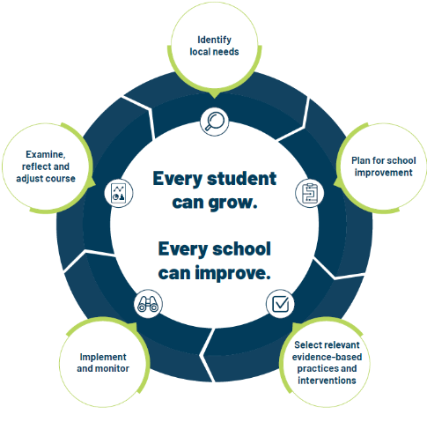
School Improvement Planning Process
Aligned to District Improvement Goals. (on-going)
Continuous and collaborative process.
Reviewed annually, monitored throughout the year- QPS uses quarterly check-in cycles.
Plan identifies strengths and weaknesses in school level systems. Staff uses the information to making deliberate, positive, cohesive, and observable changes.
Unique to each schools needs while staying in line with District Goals/Strategic Plan

Slide 3
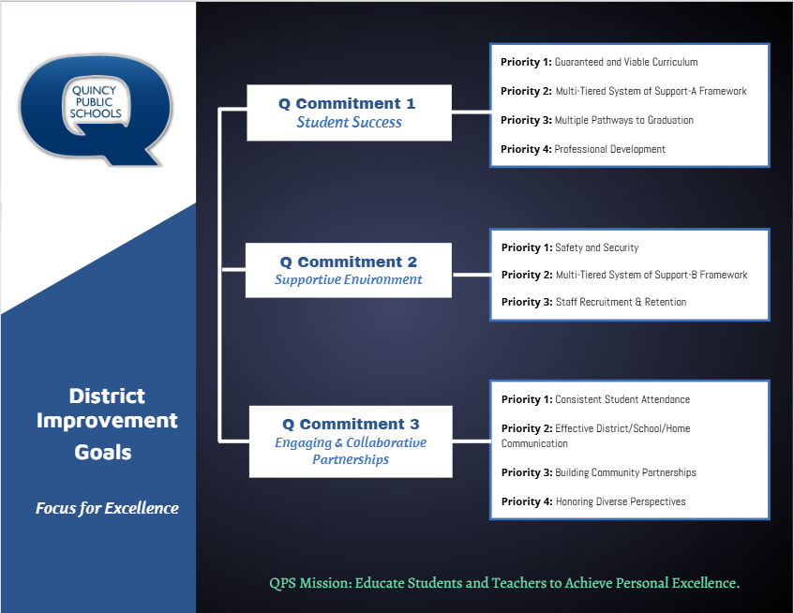

Slide 4
Q Commitment Goal 1 STUDENT SUCCESS | Priority 1: Guaranteed and viable curriculum Clear expectations in all content areas so all students have an equal opportunity to learn essential content and skills identified for each grade level and course.
 | Priority 2: Multi-tiered System of Support Framework Responsive to student learning needs through intervention, strategies, and supports.
 | Priority 3: Multiple Pathways to Graduation Reflecting opportunities for success in college and/or the workforce upon graduation.
 | Priority 4: Professional Development Targeted professional learning for staff aligned to best practice to ensure equitable access to high quality instruction for students.
Q Commitment Goal 1: Guiding Question(s) for SIP
Who is demonstrating success in our school? Who is not?
What does the data tell us about our progress toward student success and areas of concern?
What does the data tell us about our progress toward Q Goal 1success?
What are the staff needs to achieve Q Commitment Goal 1 success? (Consider: PD, systems alignment, staff alignment, etc.)

Slide 5
DENMAN ELEMENTARY – SCHOOL IMPROVEMENT PLAN 2025-2026
Q COMMITMENT GOAL 1: STUDENT SUCCESS
LITERACY | Denman Falcons will increase achievement in reading as measured by the NWEA MAP Assessment – Fall 2025 to Spring 2026.
MATH | Denman Falcons will increase achievement in math as measured by the NWEA MAP Assessment – Fall 2025 to Spring 2026.
MEASURES OF SUCCESS (Data/Progress Monitoring)
NWEA MAP- ELA/MATH​ Grade Report- Fall, Winter, Spring ​ Hi Avg and Hi >60th percentile ​ MAP School Profile Report- Spring, Fall, Winter, Spring ​ ​ Reported at % of students > 61%​ Spring 25- Read: 42% Lang: 40% Math: ​51% Fall 25- Read: Lang: Math: ​ Winter 26- Read: Lang: Math: ​ Spring 26- Read: Lang: Math: |  |  | ILLINOIS ASSESSMENT OF READINESS- ELA/MATH​ 2024 to 2025 to 2026 Math and ELA ​ Cohort 3rd to 4th , 4th to 5th ​ Below, Approaching, Meets, Exceeds​ ​ Reported as % of cohort scoring a Meets or Exceeds | CLASSROOM ASSESSMENTS- ELA/MATH​ Weekly, Monthly, By Trimester | SCHOOL-WIDE PD FEEDBACK Track quality of provided PD Microsoft Forms surveys
SCHOOL LEVEL STRATEGIES (Actions/Tasks)
PROFESSIONAL DEVELOPMENT |  | Classroom teachers will work though collective efficacy cycles determined by their grade-level teams to improve evidence-based and high-leverage literacy practices aligned to standards through implementation of Benchmark Workshop. (Focus: Student Engagement, Instruction, Differentiation (small groups), and Assessment)
PROFESSIONAL DEVELOPMENT |  | Classroom teachers will work though collective efficacy cycles determined by their grade-level teams to improve evidence-based and high-leverage mathematical practices aligned to standards through implementation of Reveal Math. (Focus: Student Engagement, Instruction, Differentiation (small groups), and Assessment)
INSTRUCTIONAL PRACTICE |  | Increase activity-based explorations, enhance problem-solving opportunities, eSpark/ALEKS Assignments, Instructional Coaching Cycles, and School Challenges

Slide 6
Q Commitment Goal 2 SUPPORTIVE ENVIRONMENT | Priority 1: Safety & Security Clear expectations for school behavior and a systematic approach to student discipline so that all have an equal opportunity to learn, belong, and succeed.​ ​
 | Priority 2: Multi-tiered System of Support Responsive to student social and emotional needs through intervention, strategies and supports.​
 | Priority 3: Staff Recruitment & Retention A systematic approach that encourages staff support and professional growth while focusing on recruitment and retention of a highly qualified and diverse staff.
Q Commitment Goal 2: Guiding Question(s) for SIP
Who is thriving in our school? Who is not?
What does the data tell us about our progress toward supportive environment and areas of concern?
What does the data tell us about our progress toward Q Goal 2 success?
What are the needs of our staff to achieve Q Commitment Goal 2 success? (Consider: PD, systems alignment, staff alignment, etc.)

Slide 7
DENMAN ELEMENTARY - SCHOOL IMPROVEMENT PLAN 2025-2026
Q COMMITMENT GOAL 2: SUPPORTIVE ENVIRONMENT
STUDENT DISCIPLINE | Denman Falcons will promote a positive and engaging learning environment that supports the needs of all learners. By June 1, 2026, 87% of Denman Falcons will be on track in behavior. (2024-2025 students on track behavior =86%) *On Track = behavior incidents on 2% or less of school days attended *District Goal: By June 1, 2026, 85% of QPS students will be on track
MEASURES OF SUCCESS (Data/Progress Monitoring)
SKYWARD DISCIPLINE DATA​ Referrals by incident​ Total number ODRs​ OSS/ISS Days |  |  | SEL INTERVENTION DATA​ Monthly, Quarter, Trimester​ Responding | PANORAMA BEHAVIOR DATA​ Critical and At-Risk Behavior Data- Monthly​ Intervention Data
SCHOOL LEVEL STRATEGIES (Actions/Tasks)
PROFESSIONAL DEVELOPMENT |  | Staff will engage in professional development sessions to build capacity around restorative practices and zones of engagement.
ADMINISTRATIVE/SE TEAM PRACTICE |  | Re-Entry guardian & student meetings, R&R, SEG groups, Tier II and Tier III problem-solving meetings
INSTRUCTIONAL PRACTICE |  | Individual classroom boosters and positive acknowledgements across building

Slide 8
Q Commitment Goal 3 ENGAGING AND COLLABORATIVE PARTNERSHIPS | Priority 1: ​Consistent Student Attendance Focus on the benefits of regular school attendance and links to student long term success.
 | Priority 2: Effective District/School/Home Communication Ensure parents, students, and families have consistent communication regarding district and school information and clear points of contact when questions arise.
 | Priority 3: Building Community Partnerships Collaborate with local community organizations to expand opportunities for all students.
 | Priority 4: Honoring Diverse Perspectives Recognize the diversity within our schools and community and ensure all voices are represented and heard.
Q Commitment Goal 3: Guiding Question(s) for SIP
Who is connected at our school? Who is not?
What does the data tell us about our progress toward engaging and collaborative partnerships and areas of concern?
What does the data tell us about our progress toward Q Goal 3 success?
What are the needs of our staff to achieve Q Commitment Goal 3 success? (Consider: PD, systems alignment, staff alignment, etc.)

Slide 9
DENMAN ELEMENTARY – SCHOOL IMPROVEMENT PLAN 2025-2026
6Q COMMITMENT GOAL 3: ENGAGING AND COLLABORATIVE PARTNERSHIPS
STUDENT ATTENDANCE | By June 1, 2026, 95% of Denman Falcons will be on track in school attendance. *2024-2025 students on track in school attendance = 94% *On track = attending school 90% of the time or more. *QPS District Goal: By June 1, 2026, 80% of QPS students will be on track with student attendance
MEASURES OF SUCCESS (Data/Progress Monitoring)
SKYWARD ATTENDANCE DATA​ Students at 90% or above​ Students below 90% attendance​ 9 or more absences |  |  | FAMILY ENGAGEMENT Number of student/classroom digital showcases per month. Parent ratings (1-5) of school-wide family activities. | COMMUNITY ENGAGEMENTS​ Opportunities per month/trimester | 5ESSENTIALS PARENT SURVEY DATA​ Supportive Environment​ Ambitious Instruction​ Informed Families
SCHOOL LEVEL STRATEGIES (Actions/Tasks)
STUDENT ATTENDANCE |  | Improve recognition and incentives for student attendance for both students and parents.
FAMILY ENGAGEMENT |  | Enhance current parent engagement activities and explore new opportunities for parents to engage with their child’s school/teachers to increase the home school partnership. Focus on providing parents a front row seat to their child’s learning through digital showcases. (Ex, Seesaw classroom museums, activity spotlights, exemplary work) Classroom teachers will provide monthly communication to families through a newsletter, video walkthrough, classroom blog.
COMMUNITY PARTNERSHIPS/ENGAGEMENT |  | Enhance and strengthen established community partnerships. Explore opportunities for new partnerships with others in our community.

