Slide 1
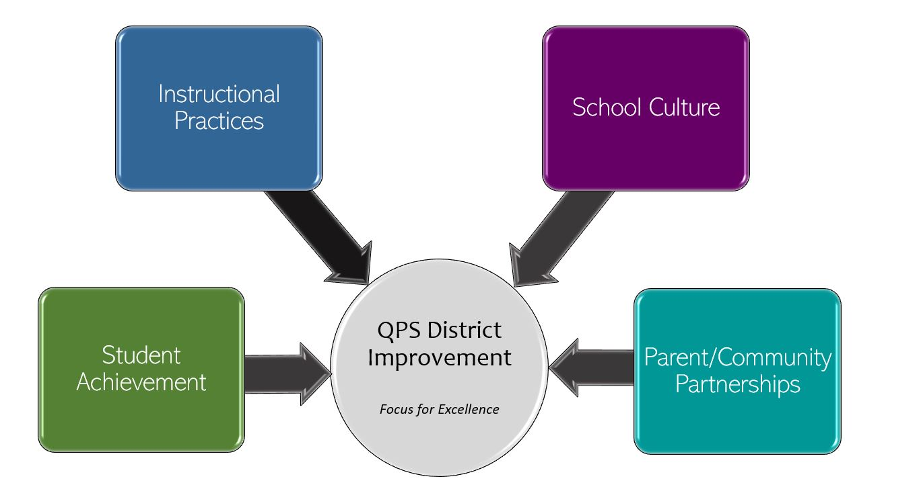
Early Childhood and Family Center School Improvement 2022-2023 Focus for Excellence
Goal 1- Student Achievement | Alignment to District Q Goal 1
Students will increase letter and number knowledge. Growth of letter and number knowledge will be determined by the September 2022/Beginning of the year benchmark data. | QPS WILL increase student achievement and growth in grades PK-12. *Evidenced by: State and local assessment data and MTSS intervention data.
Evidenced by: (Data/Monitoring)
Name identification (Students ID their name from a sample of 3 names) Number count (Students rote count to 5) Weekly classroom tracking- report Reflection on weekly reported data at PLCs- Monthly
School Tasks and Staff Professional Development to Support Goal
Instructional coach will teach data collection system and practices at the first PLC meeting and provide support to staff thereafter.

Slide 2
Early Childhood and Family Center School Improvement 2022-2023 Focus for Excellence
Goal 2- Instructional Practice | Alignment to District Q Goal 2
100% of teachers will teach Second Step lessons daily | QPS WILL utilize standards-based curriculum maps to ensure a guaranteed and viable curriculum is provided for all students and work in professional learning communities to plan for instruction that promotes critical thinking, collaboration, creativity, and engagement. *Evidenced by: School culture data, instructional practices data, state and local assessment data
Evidenced by: (Data/Monitoring)
Monthly classroom observations data (during Second Step scheduled time) Analyze MTSS tiered data (Universal tier- monthly, Tiered data-Weekly)
School Tasks and Staff Professional Development to Support Goal
Grounding of Second Step Curriculum with all staff on August 15th- Teacher Institute. SEL Coach will share and teacher staff the Second Step curriculum map/pacing SEL Coach will support individual staff with implementation and provide on-going support at PLC meetings.

Slide 3
Early Childhood and Family Center School Improvement 2022-2023 Focus for Excellence
Goal 3- School Culture | Alignment to District Q Goal 3
All teachers will participate in peer observations cycles to create a culture of collaboration. | QPS WILL maintain and safe, healthy, supportive and equitable environment for all students and staff. *Evidenced by: School Culture Data, Discipline Data, Teacher Retention data, and MTSS data
Evidenced by: (Data/Monitoring)
Observation schedule Observation notes and reflective questions to complete after the observation
School Tasks and Staff Professional Development to Support Goal
Director/Coaches will share out the plan in August and ongoing, as needed. Director/Coaches will use staff notes and reflection forms to determine what has been implemented and what areas still need support PLC time to share observations with colleagues on takeaways from the observations Observation share outs at staff meeting to expand the culture of collaboration with all staff

Slide 4
Early Childhood and Family Center School Improvement 2022-2023 Focus for Excellence
Goal 4- Parent/Community Partnerships | Alignment to District Q Goal 4
100% of classrooms will report ¼ of student families represented at a minimum of 2 family engagement events and activities. | QPS WILL strengthen parent support and community engagement by building positive relationships and communication between parents, families, schools and community to foster success for all students. Evidenced by: Attendance and truancy data, parent event attendance data, parent survey data, discipline data
Evidenced by: (Data/Monitoring)
Family sign-in sheets monitored and reported to FSS coordinator by Family Support Specialists and/or staff member supervising events
School Tasks and Staff Professional Development to Support Goal
Leadership share our plan/purpose to all staff- August 15th Family Support Specialist (FSS) Coordinator/ Instructional Coach will teach the importance to teachers by Sept. 14 PLC FSS report to coordinator in monthly report FSS Coordinator reports to leadership (Monthly) FSS Coordinator/Director shares data to staff monthly (staff meeting or staff newsletter)

