Slide 1
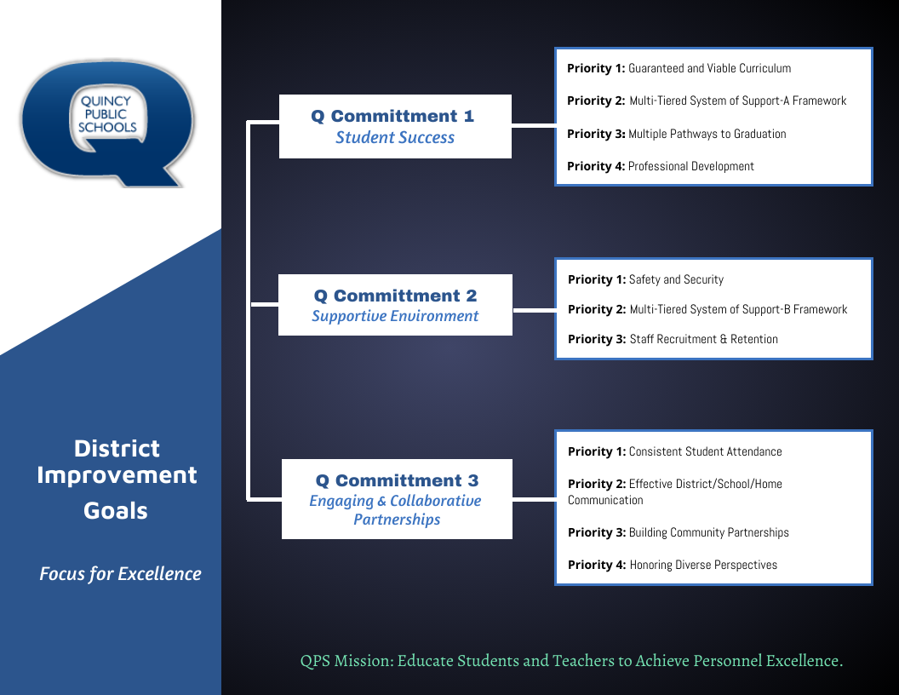

Slide 2
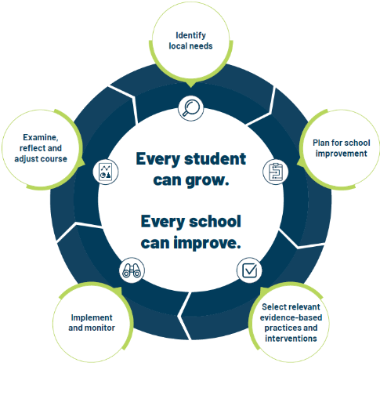
School Improvement Planning Process
Aligned to District Improvement Plan. (on-going)
Continuous and collaborative process.
Reviewed annually, monitored throughout the year- QPS uses three check-in cycles- Fall, Winter, Spring.
Plan identifies strengths and weaknesses in school level systems. Staff uses the information to making deliberate, positive, cohesive, and observable changes.
Unique to each schools needs while staying in line with District Commitment Goals/Improvement Plan.

Slide 3
Q Commitment Goal 1 STUDENT SUCCESS | Priority 1: Guaranteed and viable curriculum Clear expectations in all content areas so all students have an equal opportunity to learn essential content and skills identified for each grade level and course.
 | Priority 2: Multi-tiered System of Support Framework Responsive to student learning needs through intervention, strategies, and supports.
 | Priority 3: Multiple Pathways to Graduation Reflecting opportunities for success in college and/or the workforce upon graduation.
 | Priority 4: Professional Development Targeted professional learning for staff aligned to best practice to ensure equitable access to high quality instruction for students.
Q Commitment Goal 1: Guiding Question(s) for SIP
Who is demonstrating success in our school? Who is not?
What does the data tell us about our progress toward student success and areas of concern?
What does the data tell us about our progress toward Q Goal 1success?
What are staff needs of staff and what supports are needed for Q Goal 1 success?

Slide 4

EARLY CHILDHOOD AND FAMILY CENTER (ECFC) – SCHOOL IMPROVEMENT PLAN 2024-2025
Q COMMITMENT GOAL 1: STUDENT SUCCESS
LITERACY | By June 1, 2025, all ECFC students will increase literacy/letter identification from their baseline data in September. 80% of ECFC students will meet or exceed letter identification as measured by the Teaching Strategies GOLD standards.
MATH | By June 1, 2025, all ECFC students will increase math/numerical identification from their baseline data in September. 75% of ECFC students will meet or exceed numerical identification as measured by the Teaching Strategies GOLD standards.
MEASURES OF SUCCESS (Data/Progress Monitoring)
LETTER IDENTIFICATION ASSESSMENT Baseline/September Fall/November Winter Data/February Spring Data/May |  |  | NUMBER IDENTIFICATION ASSESSMENT Baseline/September Fall/November Winter Data/February Spring Data/May | GOLD Observation Notes GOLD Assessment | STAFF SURVEY- PROFESSIONAL DEVELOPMENT Pre/Post- Needs Assessment
SCHOOL LEVEL STRATEGIES (Actions/Tasks)
INSTRUCTIONAL PLANNING |  | Review and discuss student data results- PLC monthly
PROFESSIONAL DEVELOPMENT |  | Conduct a professional development needs assessment to determine interests and professional learning needs for staff to provide instruction and supports that meet the learning needs of pre-school students. (Pre/Post Assessment)
PROFESSIONAL DEVELOPMENT |  | Utilize the results of the professional development needs assessment to provide differentiated opportunities for all staff professional learning. The expertise of current internal staff as well as outside professional development presenters will be utilized.

Slide 5
Q Commitment Goal 2 SUPPORTIVE ENVIRONMENT | Priority 1: Safety & Security Clear expectations for school behavior and a systematic approach to student discipline so that all have an equal opportunity to learn, belong, and succeed.​ ​
 | Priority 2: Multi-tiered System of Support Responsive to student social and emotional needs through intervention, strategies and supports.​
 | Priority 3: Staff Recruitment & Retention A systematic approach that encourages staff support and professional growth while focusing on recruitment and retention of a highly qualified and diverse staff.
Q Commitment Goal 2: Guiding Question(s) for SIP
Who is thriving in our school? Who is not?
What does the data tell us about our progress toward supportive environment and areas of concern?
What does the data tell us about our progress toward Q Goal 2 success?
What are staff needs of staff and what supports are needed for Q Goal 2 success?

Slide 6
EARLY CHILDHOOD AND FAMILY CENTER (ECFC) --- SCHOOL IMPROVEMENT PLAN 2024-2025
Q COMMITMENT GOAL 2: SUPPORTIVE ENVIRONMENT
DISCIPLINE | By June 1, 2025, discipline referrals for physical aggression will decrease by 20% from the 2023-2024 school year. *2023-2024 Data: Total referrals for Physical Aggression=333 referrals. 20% would be a reduction of 67 physical aggression.
MEASURES OF SUCCESS (Data/Progress Monitoring)
SKYWARD/PANORAMA BEHAVIOR DATA Referral data by behavior - monthly |  |  | STAFF RETENTION DATA 5Essentials data - School Commitment | MTSS DATA SE and Behavior intervention data/results of intervention (weekly/monthly/quarterly) | STAFF/PARENT SURVEY Pre-Post - Knowledge and Implementation of Conscious Discipline in the home
SCHOOL LEVEL STRATEGIES (Actions/Tasks)
INSTRUCTIONAL PRACTICE |  | ECFC will conduct 5 walk-throughs (August/ September, October/November, December/January, February/March, April/May) to observe implementation of Second Step Curriculum with fidelity and implementation of Conscious Discipline strategies.
PROFESSIONAL DEVELOPMENT |  | ECFC will provide a professional learning opportunity on Conscious Discipline in June for all staff.
PROFESSIONAL DEVELOPMENT |  | Teachers and paraeducator classroom teams will engage in Conscious Discipline coaching from master trainer Kim Hughes.
PROFESSIONAL DEVELOPMENT |  | The ECFC Social Emotional (SE) Leader will engage in training around Restorative Practices and Trauma informed practices to provide support, training, and implementation of SE systems at ECFC.
PARENT/SCHOOL PARTNERSHIP |  | Parent Involvement activities (see Q Goal 3) will focus on student behavior expectations at ECFC. (Parent café, parent contacts, Parent/School Collaboration meetings)

Slide 7
Q Commitment Goal 3 ENGAGING AND COLLABORATIVE PARTNERSHIPS | Priority 1: ​Consistent Student Attendance Focus on the benefits of regular school attendance and links to student long term success.
 | Priority 2: Effective District/School/Home Communication Ensure parents, students, and families have consistent communication regarding district and school information and clear points of contact when questions arise.
 | Priority 3: Building Community Partnerships Collaborate with local community organizations to expand opportunities for all students.
 | Priority 4: Honoring Diverse Perspectives Recognize the diversity within our schools and community and ensure all voices are represented and heard.
Q Commitment Goal 3: Guiding Question(s) for SIP
Who is connected at our school? Who is not?
What does the data tell us about our progress toward engaging and collaborative partnerships and areas of concern?
What does the data tell us about our progress toward Q Goal 3 success?
What are staff needs of staff and what supports are needed for Q Goal 3 success?

Slide 8
EARLY CHILDHOOD AND FAMILY CENTER (ECFC) – SCHOOL IMPROVEMENT PLAN 2024-2025
Q COMMITMENT GOAL 3: ENGAGING AND COLLABORATIVE PARTNERSHIPS
PARENT/FAMILY PARTNERSHIPS | 80% of ECFC parents/guardians will participate in a minimum of one family engagement opportunity per trimester during the 2024-2025 school year.
MEASURES OF SUCCESS (Data/Progress Monitoring)
PARENT EVENT SIGN IN Attendance at each event |  |  | SURVEY OF FAMILY PREFERENCES FOR EVENTS AND ENGAGEMENT Completed in August 2024 at Meet the Teacher appointments | TRIMESTER SURVEY PARENT/GUARDIANS Feedback regarding events offered and impact on school connection/student and family needs.
SCHOOL LEVEL STRATEGIES (Actions/Tasks)
TRIMESTER 1 (AUGUST –OCTOBER) |  | Meet the Teacher, Curriculum Night, Meals with Misters, Fall Conscious Discipline Parent Education, Policy Council, Volunteer Opportunities for families and community members, and Parent Cafés.
TRIMESTER 2 (NOVEMBER-FEBRUARY) |  | Happy Halls, Parent Cafés, Fall Conscious Discipline Parent Education, Policy Council, Volunteer Opportunities, Night at the North Pole, Fall Parent Teacher Conferences, and Home Visits.
TRIMESTER 3 (MARCH-MAY) |  | Parent Teacher Conferences, Home Visits, Family Art Café, Spring Conscious Discipline Parent Education, Family Fit Night, Family Connection Café, Pre-School Prom, Moments with Misses

