Slide 1
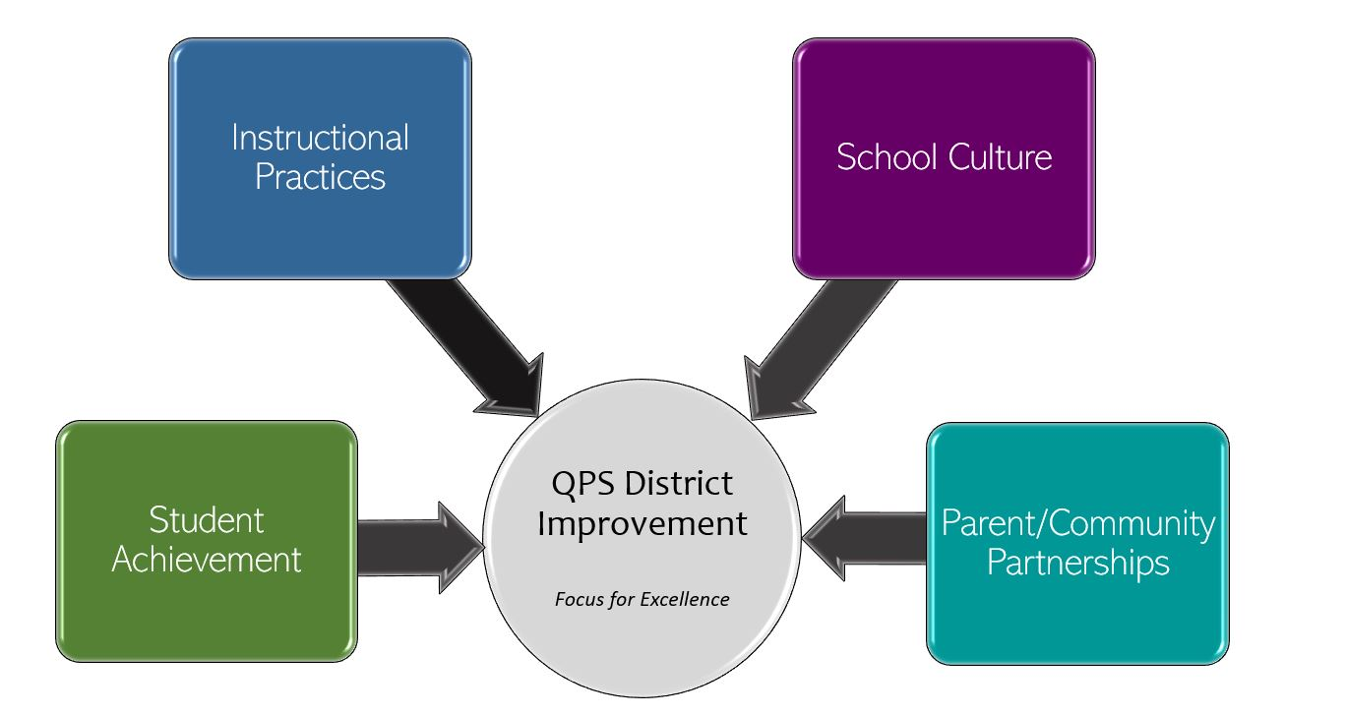
Colonel George J. Iles Elementary School Improvement 2022-2023 Focus for Excellence
Goal 1- Student Achievement | Alignment to District Q Goal 1
At Iles Elementary, we will increase student achievement in the areas of Math and ELA by 4% as measured by NWEA MAP Assessment from Fall 2022-Spring 2023. (Grade Report HiAvg and Hi categories >60%) | QPS WILL increase student achievement and growth in grades PK-12. *Evidenced by: State and local assessment data and MTSS intervention data.
Evidenced by: (Data/Monitoring)
Classroom Assessments-weekly, monthly, quarterly MAP Assessments-Fall, Winter, Spring Illinois Assessment of Readiness-yearly
School Tasks and Staff Professional Development to Support Goal
Math Actions | Math Actions | ELA Actions | ELA Actions
Basic Facts/Fact Fluency | Number Talks | Benchmark Phonics | Virtual Reading Opportunities
STEAM Opportunities | Number Sense Lessons | Writing About Reading | Comprehension Focus Lessons
Writing About Math | Tier I Math Supports | Building Reading Stamina | Using MAP Data to Guide Instruction
Small Group Math Opportunities (Differentiate EM Lessons, Guided Math) | Making Math Engaging -Hands-on Math Opportunities | ELA Best Practices -Reading Workshop -Tier I Instruction | Grounding on Successful readers and writers
Integrating Writing in All Content Areas | Problem Solving/Explanation | Family Partnerships in Reading | Close Reads Vocabulary

Slide 2
Colonel George J. Iles Elementary School Improvement 2022-2023 Focus for Excellence
Goal 2- Instructional Practices | Alignment to District Q Goal 2
At Iles Elementary, we will use QPS curriculum maps and student assessment data to engage our students and guide our instruction. | QPS WILL utilize standards-based curriculum maps to ensure a guaranteed and viable curriculum is provided for all students and work in professional learning communities to plan for instruction that promotes critical thinking, collaboration, creativity and engagement. *Evidenced by: School culture data, state and local assessment data, instructional practice data
Evidenced by: (Data/Monitoring)
Classroom Assessments-monthly, quarterly Peer Observations- twice yearly Weekly MTSS Collaboration 5 Essentials
School Tasks and Staff Professional Development to Support Goal
Instructional Practice Actions
Peer Observations | Best Practice
Data “Wall” | ACSD Quick Reference Guides
Curriculum Maps-Pacing and Monitoring | Illinois Learning Standards
Grounding in all Curricular Areas | Using MAP To Guide Instruction

Slide 3
Colonel George J. Iles Elementary School Improvement 2022-2023 Focus for Excellence
Goal 3- School Culture | Alignment to District Q Goal 3
At Iles Elementary, we will decrease the total number of ODRs by 10% from the 2022 SY. | QPS WILL maintain and safe, healthy, supportive and equitable environment for all students and staff. *Evidenced by: School Culture Data, Discipline Data, Teacher Retention data and MTSS data
Evidenced by: (Data/Monitoring)
2022 SY- 1,126 Skyward Discipline Data-monthly, quarterly SWIS Data- bi-weekly 5 Essentials Data-yearly
School Tasks and Staff Professional Development to Support Goal
School Culture Actions | School Culture Actions
Restorative Practices | De-escalating Strategies | Trauma Informed Training | Buddy Classrooms
Executive Functioning Training | Engaging/Motivating Students | Cool Down Areas | Grounding on Expectations and Skyward Entries
Cohesion (Essential 55, Guiding Principals, etc.)

Slide 4
Colonel George J. Iles Elementary School Improvement 2022-2023 Focus for Excellence
Goal 4- Parent/Community Partnerships | Alignment to District Q Goal 4
At Iles Elementary, we will increase parent attendance in our building by 10% from the 2022 SY as measured by event opportunities and attendance. | QPS WILL strengthen parent support and community engagement by building positive relationships and communication between parents, families, schools and community to foster success for all students. *Evidenced by: Attendance and truancy data, parent event attendance, parent survey data, discipline data
Evidenced by: (Data/Monitoring)
Parent Event Attendance Parent Survey Data 5 Essentials Data-yearly Attendance Data-weekly, monthly, quarterly, yearly
School Tasks and Staff Professional Development to Support Goal
Parent/Community Involvement Actions
Grade Level Performances | Read/STEAM/PE Nights | Madison Park Church Partnership | Donuts with Grownups
Grade Level Adult/Child Activities | Newsletters | Parent Surveys | Parent Podcasts
Increased Social Media Presence | Parent Podcasts | School Clubs | Parent and/or Informational Classes with Community Agencies

