Slide 1
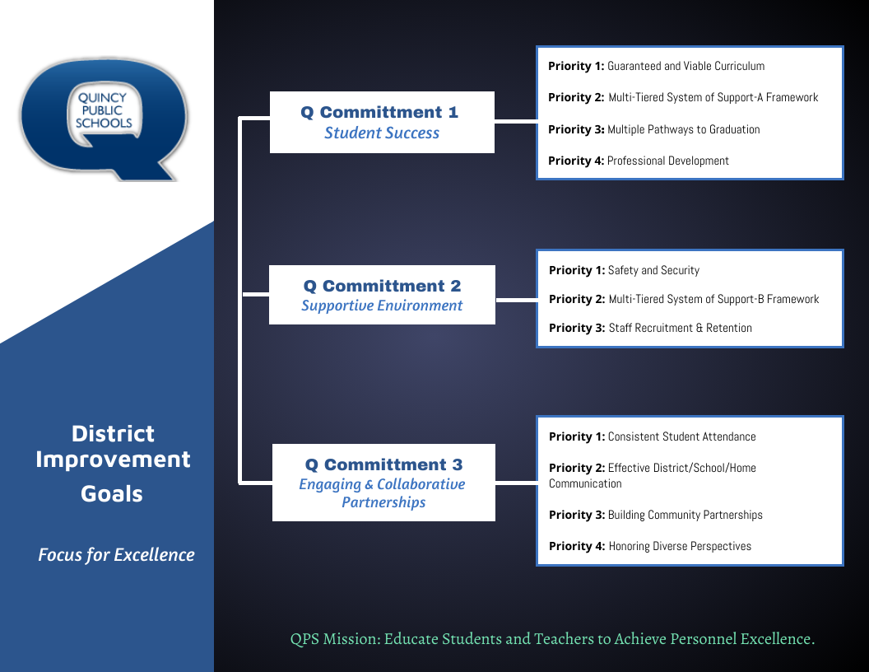

Slide 2
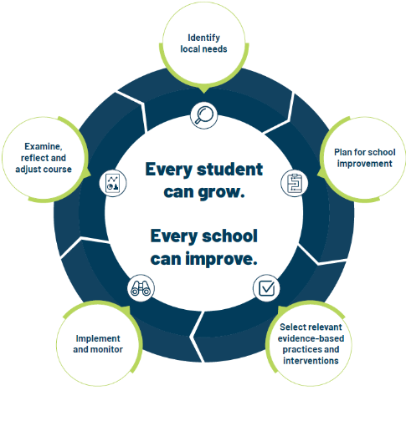
School Improvement Planning Process
Aligned to District Improvement Plan. (on-going)
Continuous and collaborative process.
Reviewed annually, monitored throughout the year- QPS uses three check-in cycles- Fall, Winter, Spring.
Plan identifies strengths and weaknesses in school level systems. Staff uses the information to making deliberate, positive, cohesive, and observable changes.
Unique to each schools needs while staying in line with District Commitment Goals/Improvement Plan.

Slide 3
Q Commitment Goal 1 STUDENT SUCCESS | Priority 1: Guaranteed and viable curriculum Clear expectations in all content areas so all students have an equal opportunity to learn essential content and skills identified for each grade level and course.
 | Priority 2: Multi-tiered System of Support Framework Responsive to student learning needs through intervention, strategies, and supports.
 | Priority 3: Multiple Pathways to Graduation Reflecting opportunities for success in college and/or the workforce upon graduation.
 | Priority 4: Professional Development Targeted professional learning for staff aligned to best practice to ensure equitable access to high quality instruction for students.
Q Commitment Goal 1: Guiding Question(s) for SIP
Who is demonstrating success in our school? Who is not?
What does the data tell us about our progress toward student success and areas of concern?
What does the data tell us about our progress toward Q Goal 1success?
What are staff needs of staff and what supports are needed for Q Goal 1 success?

Slide 4

ELEMENTARY K-5 – SCHOOL IMPROVEMENT PLAN 2024-2025
Q COMMITMENT GOAL 1: STUDENT SUCCESS
ELA/LITERACY | By June 1, 2025, K-5 elementary students will increase achievement and/or growth in Reading as measured by the NWEA MAP assessment Fall 2024 to Spring 2025.
MATH | By June 1, 2025, QPS K-5 elementary students will increase achievement and/or growth in Math as measures by the NWEA MAP assessment Fall 2024 to Spring 2025.
MEASURES OF SUCCESS (Data/Progress Monitoring)
NWEA MAP- ELA/Math Grade Report- Fall, Winter, Spring Hi Avg and Hi>60th percentile MAP School Profile Report |  |  | IAR- ILLINOIS ASSESSMENT OF READINESS 2023 to 2024 to 2025 Math and ELA Cohort 3rd to 4th and 4th to 5th Below, Approaching, Meets, Exceeds | CLASSROOM ASSESSMENTS- ELA/MATH Weekly, Monthly, By Trimester | STAFF SURVEY- PROFESSIONAL DEVELOPMENT Pre/Post- Needs Assessment
SCHOOL LEVEL STRATEGIES (Actions/Tasks)
PROFESSIONAL DEVELOPMENT |  | Classroom teachers will engage in professional learning to improve evidence-based and high-leverage literacy practices aligned to standards through implementation of Benchmark Workshop. (Focus: Instruction, Differentiation, and Assessment)
PROFESSIONAL DEVELOPMENT |  | Classroom teachers will engage in professional learning to improve evidence-based and high-leverage mathematical practices aligned to standards through implementation of Reveal Math. (Focus: Instruction, Differentiation, and Assessment)

Slide 5
Q GOAL 1 SCHOOL LEVEL STRATEGIES (Actions/Tasks)– K-5 Elementary
PROFESSIONAL DEVELOPMENT | Baldwin | Classroom teachers will engage in professional learning to build capacity in assessment data to guide instructional practice and supports for student learning. Continuation of Efficacy Cycles. Leadership articles and discussion based on assessment: teaching and learning. Academic Intervention team will review student placement needs for math and ELA.
INSTRUCTIONAL PRACTICE | Denman | Classroom teachers will engage in grade-level collective efficacy cycles to promote student self-engagement and productive struggle through the implementation of inquiry-based learning.
PROFESSIONAL DEVELOPMENT | Lincoln Douglas | Classroom teachers will engage in professional learning around the literacy footprints assessment implementation and review results as a comparative point of student learning data.
PROFESSIONAL DEVELOPMENT | Rooney | Classroom teachers will engage in professional learning to build capacity to increase instructional practice and build supports for student learning.​ ​Grade level peer observations and reflections.

Slide 6
Q Commitment Goal 2 SUPPORTIVE ENVIRONMENT | Priority 1: Safety & Security Clear expectations for school behavior and a systematic approach to student discipline so that all have an equal opportunity to learn, belong, and succeed.​ ​
 | Priority 2: Multi-tiered System of Support Responsive to student social and emotional needs through intervention, strategies and supports.​
 | Priority 3: Staff Recruitment & Retention A systematic approach that encourages staff support and professional growth while focusing on recruitment and retention of a highly qualified and diverse staff.
Q Commitment Goal 2: Guiding Question(s) for SIP
Who is thriving in our school? Who is not?
What does the data tell us about our progress toward supportive environment and areas of concern?
What does the data tell us about our progress toward Q Goal 2 success?
What are staff needs of staff and what supports are needed for Q Goal 2 success?

Slide 7
Q GOAL #2- ELEMENTARY K-5 SCHOOL IMPROVEMENT PLAN 2024-2025
Q COMMITMENT GOAL 2: SUPPORTIVE ENVIRONMENT
STUDENT DISCIPLINE |  | By June 1, 2025, 85% of QPS students will be on track in school behavior (on track = behavior incidents on 2% or less of school days attended.)​ ​ *2023-2024 students on track discipline- District= 80% Baldwin (82%); Denman (84%); Iles (80%); Lincoln Douglas (85%); Rooney (83%)
MEASURES OF SUCCESS (Data/Progress Monitoring)
SKYWARD DISCIPLINE DATA Referrals by incident Total number ODRs OSS/ISS Days |  |  | PANORAMA BEHAVIOR DATA Critical and At-Risk Behavior Data- Monthly Intervention Data | SEL INTERVENTION DATA Monthly, Quarter, Trimester Responding | STAFF DISCIPLINE SURVEY Fall- Winter- Spring
SCHOOL LEVEL STRATEGIES (Actions/Tasks)
PROFESSIONAL DEVELOPMENT | Classroom teachers, support staff and paraeducators will engage in five professional development sessions to build capacity around restorative practices in classrooms and schools. Introduction to RP, Proactive Community Building with Circles, The Social Discipline Window, Affective and Non-Judgmental Language, Restorative Chats and Mediation
PROFESSIONAL DEVELOPMENT | School staff will continue building capacity around trauma informed practices in the classroom in school specifically connected to classroom management strategies.
INSTRUCTIONAL PRACTICE | Ron Clark House System Implementation

Slide 8
Q GOAL 2 SCHOOL LEVEL STRATEGIES (Actions/Tasks)- K-5 ELEMENTARY
INSTRUCTIONAL PRACTICE/MTSS | Baldwin | PBIS Systems: We are collaborating to integrate PBIS, House Teams, and TSB Essential 16 for standards to live by.
INSTRUCTIONAL PRACTICE | Baldwin | Ron Clark House System: We will work to increase awareness by displaying information around the building, providing announcements, providing House team meeting times, and offering challenges for House teams.
INSTRUCTIONAL PRACTICE | Baldwin | TSB Essential 16: We have a team integrating the Essential 16 with our PBIS language. We will display language around the building and use announcements, assemblies, and media integration to showcase.
INSTRUCTIONAL PRACTICE | Denman | The School Leadership Team and teachers will implement RISS (Restorative In-School Suspension) with a focus on therapeutic approaches.
MTSS/INTERVENTION & SUPPORTS | Denman | The Social Emotional Team and teachers will implement MTSS Tier 2 and Tier 3 social emotional interventions with fidelity.
INSTRUCTIONAL PRACTICE | Denman | Ron Clark House System Implementation
INSTRUCTIONAL PRACTICE | Iles | PBIS Systems- Implementation
INSTRUCTIONAL PRACTICE | Iles | Ron Clark House System and Essential 55, Tuskegee Airman Guiding Principles- Implementation
INSTRUCTIONAL PRACTICE/MTSS | Lincoln Douglas | PBIS Implementation- re-teach expectations and routines across the building. PBIS Booster lessons every six weeks.
INSTRUCTIONAL PRACTICE/MTSS | Lincoln Douglas | Implement and clarify communication system for Tier 2 interventions (SEL)
INSTRUCTIONAL PRACTICE | Lincoln Douglas | Ron Clark House System Implementation- students and staff
INSTRUCTIONAL PRACTICE/MTSS | Rooney | Implementation- PBIS Systems/Student Leadership opportunities
INSTRUCTIONAL PRACTICE | Rooney | Ron Clark House System Implementation - students and staff

Slide 9
Q Commitment Goal 3 ENGAGING AND COLLABORATIVE PARTNERSHIPS | Priority 1: ​Consistent Student Attendance Focus on the benefits of regular school attendance and links to student long term success.
 | Priority 2: Effective District/School/Home Communication Ensure parents, students, and families have consistent communication regarding district and school information and clear points of contact when questions arise.
 | Priority 3: Building Community Partnerships Collaborate with local community organizations to expand opportunities for all students.
 | Priority 4: Honoring Diverse Perspectives Recognize the diversity within our schools and community and ensure all voices are represented and heard.
Q Commitment Goal 3: Guiding Question(s) for SIP
Who is connected at our school? Who is not?
What does the data tell us about our progress toward engaging and collaborative partnerships and areas of concern?
What does the data tell us about our progress toward Q Goal 3 success?
What are staff needs of staff and what supports are needed for Q Goal 3 success?

Slide 10
ELEMENTARY K-5 -- SCHOOL IMPROVEMENT PLAN 2024-2025
Q COMMITMENT GOAL 3: ENGAGING AND COLLABORATIVE PARTNERSHIPS
STUDENT ATTENDANCE | BY June 1, 2025, 80% of QPS students will be on track in school attendance (on track = attending school 90% of time or more) *2023-2024 students on track in school attendance= 71% Baldwin (78%); Denman (79%); Iles (80%); Lincoln Douglas (74%); (Rooney (80%)
PARENT/ FAMILY/ COMMUNITY PARTNERSHIPS | By June 1, 2025, QPS elementary schools will increase efficacy in parent/family/community communication and engagement
Q GOAL 3 Measures of Success (Data/Progress Monitoring)
SKYWARD ATTENDANCE DATA Students at 90% or above Students below 90% attendance 9 or more absences |  | PARENT EVENT ATTENDANCE DATA Number of parents/families per event | 5ESSENTIALS PARENT SURVEY DATA Supportive Environment Ambitious Instruction Informed Families | COMMUNITY ENGAGEMENTS Total number of opportunities per month/semester/quarter/trimester
Q GOAL 3 SCHOOL LEVEL STRATEGIES (Actions/Tasks)
FAMILY ENGAGEMENT | Enhance current parent engagement activities and opportunities for parents to engage with their child’s academics at school and at home. |  | Enhance current parent engagement activities
MTSS- INTERVENTION/SUPPORTS | Schedule attendance action planning meetings for students who are not attending school regularly. Partner with ROE and/or other community organizations to enhance support for action planning with families. |  | Opportunities for parents to engage in their child’s academic at school and at home.
PARENT COMMUNICATION | Parent outreach communication (via school social media sites, Skyward, etc.) outlining the importance of school attendance using current research.

Slide 11
Q GOAL 3 SCHOOL LEVEL STRATEGIES (Actions/Tasks) K-5 ELEMENTARY 2024-2025
FAMILY ENGAGEMENT | Baldwin | Enhance current parent engagement activities and opportunities for parents to engage with their child’s academics at school and at home. Continue partnerships with PTO, church affiliates, QHS clubs, and seek other community partners to provide opportunities for positive interactions and activities.
MTSS INTERVENTION/ SUPPORTS | Baldwin | Schedule attendance action planning meetings for students who are not attending school regularly. Partner with ROE and/or other community organizations to enhance support for action planning with families. Celebrate students and staff monthly who are in attendance 95% or more of the time. Provide increased opportunities for student leadership to increase sense of belonging.
PARENT/ FAMILY COMMUNICATION | Baldwin | Parent outreach communication (via school social media sites, Skyward, etc.) outlining the importance of school attendance using current research. Inform families of ongoing attendance rates, challenges, and celebrations.
PARENT/ FAMILY COMMUNICATION | Denman | -Parent outreach communication (via school social media sites, student-news crew, elementary communication apps, dedicated staff time for parent communication, Skyward, etc.) highlighting positive student achievement and behavior, school events, and the importance of attendance using current research. -Enhance current activities and opportunities for parents to engage with their child's academics at school and at home.
MTSS INTERVENTION/ SUPPORTS | Denman | Schedule attendance action planning meetings for students who are not attending school regularly. Partner with ROE and/or other community organizations to enhance support for action planning with families
COMMUNITY ENGAGEMENT | Denman | Increase community involvement through activities such as: SIP involvement, mini career fair, and RCA House assembly presentations.
FAMILY ENGAGEMENT | Iles | Enhance current parent engagement activities and explore new opportunities for parents to engage with their child’s school/teachers to increase the home school partnership. Opportunities for families to engage in child's academics at school and at home.
COMMUNITY PARTNERSHIPS/ ENGAGEMENT | Iles | Enhance and strengthen established community partnerships. Explore opportunities for new partnerships with others in our community.
FAMILY ENGAGEMENT | Lincoln Douglas | Continue family engagement events throughout the year
MTSS INTERVENTION/ SUPPORTS | Lincoln Douglas | -Continue bi-weekly Attendance Team Meetings to track attendance and creatively support the needs of LDE families. -Student attendance celebrations throughout the school year.
STUDENT ENGAGEMENT/ BELONGING | Lincoln Douglas | RCA House Meetings and student leadership opportunities-

Slide 12
Q GOAL 3 SCHOOL LEVEL STRATEGIES (Actions/Tasks) K-5 ELEMENTARY 2024-2025
FAMILY ENGAGEMENT | Rooney | Enhance current parent engagement activities and explore new opportunities for parents to engage with their child’s school/teachers to increase the home school partnership.
MTSS INTERVENTION/ SUPPORTS | Rooney | -Schedule attendance action planning meetings for students who are not attending school regularly. Partner with ROE and/or other community organizations to enhance support for action planning with families.​ -Monthly student incentives and rewards for on track attendance.
PARENT COMMUNICATION | Rooney | Improve/ Increase parent outreach communication (via school social media sites, Skyward, etc.) from classroom teachers and school.
COMMUNITY PARTNERSHIPS/ ENGAGEMENT | Rooney | Enhance and strengthen established community partnerships. Explore opportunities for partnerships recognizing the diverse population of Rooney Elementary.

