Slide 1
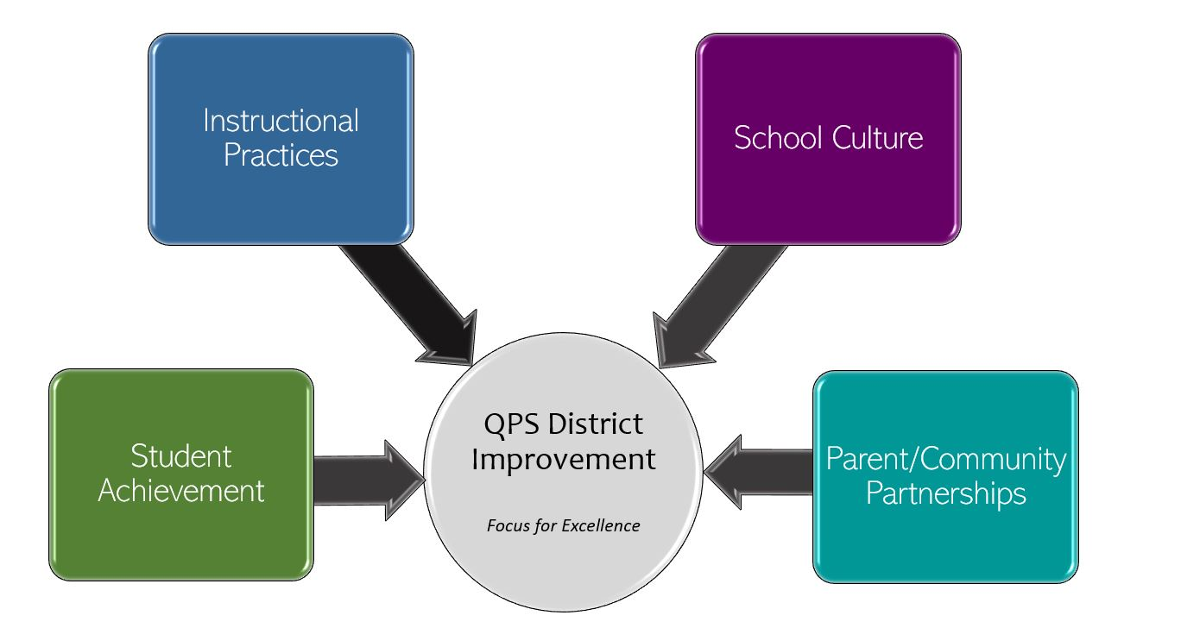
Lincoln-Douglas Elementary School Improvement 2022-2023 Focus for Excellence
Goal 1- Student Achievement | Alignment to District Q Goal 1
Students at LDE will increase the percentage of students meeting or exceeding the grade-level mean RIT on the Math MAP assessment from Spring 2022 to Spring 2023 from 55% to 58%. Students at LDE will increase the percentage of students meeting or exceeding the grade-level mean RIT on the Reading MAP assessment from Spring 2022 to Spring 2023 from 54% to 57%. Students at LDE will increase the percentage of students meeting or exceeding the grade-level mean RIT on the Language MAP assessment from Spring 2022 to Spring 2023 from 48% to 51%. | QPS WILL increase student achievement and growth in grades PK-12. *Evidenced by: State and local assessment data and MTSS intervention data.
Evidenced by: (Data/Monitoring)
NWEA MAP Data (Spring 2022 to Spring 2023) F&P Benchmark Assessment data Everyday Math Unit Assessment data Math Fact Fluency
School Tasks and Staff Professional Development to Support Goal
Math fact instruction and tracking (Basic facts, Rocket Math, Kickin’ it Math, ALEKS) with fidelity Track Everyday Math Unit Assessment scores across the school Progress monitor with F&P Benchmark Assessment 3 times per year and running records bi-weekly Professional Development on reading and planning instruction and eSpark or MyPath reports Analyze student work with Benchmark Phonic to plan instruction

Slide 2
Lincoln-Douglas Elementary School Improvement 2022-2023 Focus for Excellence
Goal 2- Instructional Practices | Alignment to District Q Goal 2
LDE teachers will utilize the curriculum maps to ensure standards are addressed with fidelity to increase student growth and achievement. | QPS WILL utilize standards-based curriculum maps to ensure a guaranteed and viable curriculum is provided for all students and work in professional learning communities to plan for instruction that promotes critical thinking, collaboration, creativity and engagement. *Evidenced by: School culture data, state and local assessment data, instructional practice data
Evidenced by: (Data/Monitoring)
Feedback on curriculum map pacing from PLC meetings Leadership Team will progress monitor participation for coaching cycles and peer observations
School Tasks and Staff Professional Development to Support Goal
Staff PD (whole group/grade-level) on curriculum map components Staff book study, “Engagement by Design” Coaches meet with teachers to determine individual teacher needs (Needs Assessment) Non-tenured teachers will participate in one coaching cycle per semester, tenured teachers will participate in one coaching cycle per school year. Teachers will participate in a minimum of three peer observations during the school year, with opportunities to provide feedback. Teachers determine areas for support and growth during grade level MTSS team meetings and common planning

Slide 3
Lincoln-Douglas Elementary School Improvement 2022-2023 Focus for Excellence
Goal 3- School Culture | Alignment to District Q Goal 3
LDE will decrease the number of daily ODRs from 3.86 to 3.5 in 2022-2023 school year. | QPS WILL maintain and safe, healthy, supportive and equitable environment for all students and staff. *Evidenced by: School Culture Data, Discipline Data, Teacher Retention data and MTSS data
Evidenced by: (Data/Monitoring)
Skyward data Panorama MTSS data SWIS data
School Tasks and Staff Professional Development to Support Goal
Implement targeted PBIS incentive/booster every six weeks PD on active supervision

Slide 4
Lincoln Douglas Elementary School Improvement 2022-2023 Focus for Excellence
Goal 4- Parent/Community Partnerships | Alignment to District Q Goal 4
Reduce Chronic truants to 7.5% of Lincoln-Douglas students Reduce truant minors to 2.2% of Lincoln-Douglas students | QPS WILL strengthen parent support and community engagement by building positive relationships and communication between parents, families, schools and community to foster success for all students. *Evidenced by: Attendance and truancy data, parent event attendance, parent survey data, discipline data
Evidenced by: (Data/Monitoring)
ROE Truancy data Skyward attendance data
School Tasks and Staff Professional Development to Support Goal
Track daily, quarterly, and yearly student attendance data Weekly attendance meetings with leadership team Creatively support family needs using school resources

