Slide 1
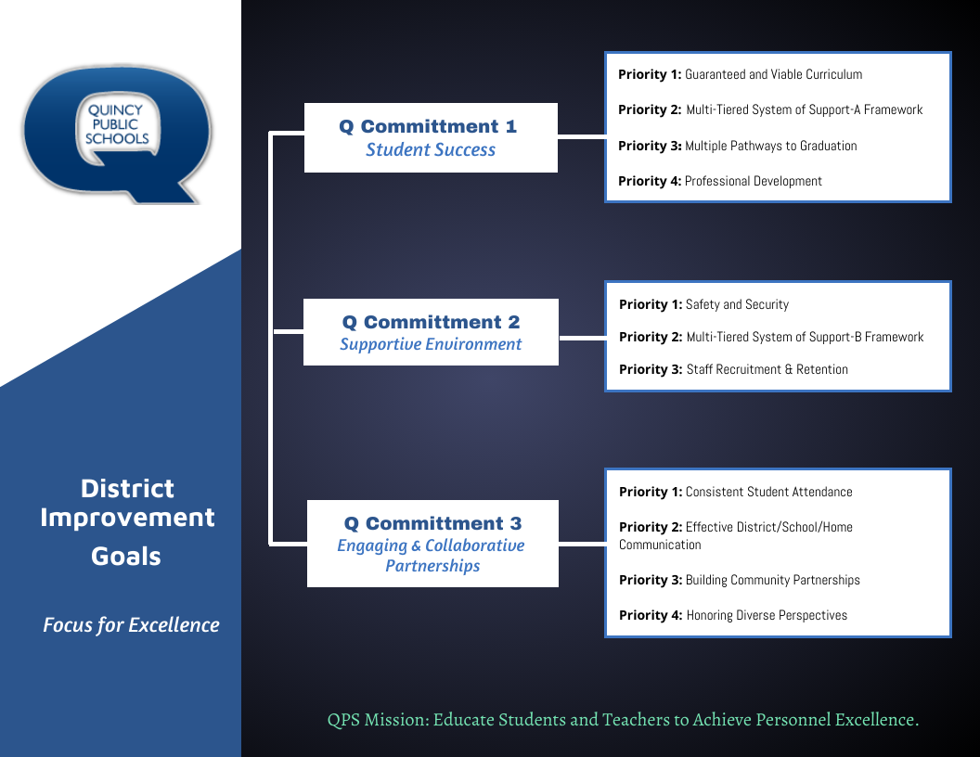

Slide 2
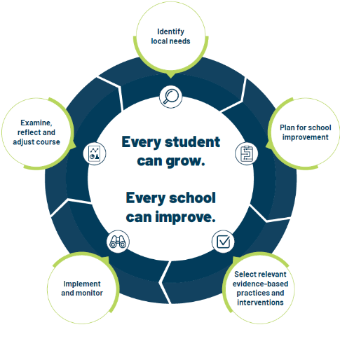
School Improvement Planning Process
Aligned to District Improvement Plan. (on-going)
Continuous and collaborative process.
Reviewed annually, monitored throughout the year- QPS uses three check-in cycles- Fall, Winter, Spring.
Plan identifies strengths and weaknesses in school level systems. Staff uses the information to making deliberate, positive, cohesive, and observable changes.
Unique to each schools needs while staying in line with District Commitment Goals/Improvement Plan.

Slide 3
Q Commitment Goal 1 STUDENT SUCCESS | Priority 1: Guaranteed and viable curriculum Clear expectations in all content areas so all students have an equal opportunity to learn essential content and skills identified for each grade level and course.
 | Priority 2: Multi-tiered System of Support Framework Responsive to student learning needs through intervention, strategies, and supports.
 | Priority 3: Multiple Pathways to Graduation Reflecting opportunities for success in college and/or the workforce upon graduation.
 | Priority 4: Professional Development Targeted professional learning for staff aligned to best practice to ensure equitable access to high quality instruction for students.
Q Commitment Goal 1: Guiding Question(s) for SIP
Who is demonstrating success in our school? Who is not?
What does the data tell us about our progress toward student success and areas of concern?
What does the data tell us about our progress toward Q Goal 1success?
What are staff needs of staff and what supports are needed for Q Goal 1 success?

Slide 4

QUINCY SENIOR HIGH SCHOOL – SCHOOL IMPROVEMENT PLAN 2024-2025
Q COMMITMENT GOAL 1: STUDENT SUCCESS
GRADUATION RATE | By June 1, 2025, QHS will increase the graduation rate by 3% or more. *23-24 Graduation rate= preliminary - 79%
MEASURES OF SUCCESS (Data/Progress Monitoring)
QHS COURSE PASS RATE By Semester QHS OLC Data Credits earned |  |  | INTERVENTION DATA Student Success Rate with intervention FLEX PROGRAM DATA Attendance, Pass Rate, Credits earned | CREDIT RECOVERY DATA By Semester | ACL CLASSROOM WALKTHROUGH DATA Academic Task-Orientated Data | Progress Monitoring: Review MAP Grade Report- Fall, Winter, Spring Hi Avg and Hi >60th percentile
SCHOOL LEVEL STRATEGIES (Actions/Tasks)
INSTRUCTIONAL PRACTICE |  | Academic Curriculum Liaisons (ACL) will lead departments in course planning and structure (deconstructing standards, refinement of curriculum maps, instructional best practice and assessment)
MTSS/INTERVENTION & SUPPORTS |  | QHS staff and administration will define Tier 1 (universal) academic interventions and monitor consistency of implementation.
STUDENT PROGRAMMING |  | QHS administration and FLEX Academy staff will refine structure, practices, and procedures in the FLEX Academy.
MTSS/INTERVENTION & SUPPORTS |  | Refine current MTSS practices and procedures (restructure intervention team and choose area of focus for implementation with fidelity).

Slide 5
Q Commitment Goal 2 SUPPORTIVE ENVIRONMENT | Priority 1: Safety & Security Clear expectations for school behavior and a systematic approach to student discipline so that all have an equal opportunity to learn, belong, and succeed.​ ​
 | Priority 2: Multi-tiered System of Support Responsive to student social and emotional needs through intervention, strategies and supports.​
 | Priority 3: Staff Recruitment & Retention A systematic approach that encourages staff support and professional growth while focusing on recruitment and retention of a highly qualified and diverse staff.
Q Commitment Goal 2: Guiding Question(s) for SIP
Who is thriving in our school? Who is not?
What does the data tell us about our progress toward supportive environment and areas of concern?
What does the data tell us about our progress toward Q Goal 2 success?
What are staff needs of staff and what supports are needed for Q Goal 2 success?

Slide 6
QUINCY SENIOR HIGH SCHOOL -- SCHOOL IMPROVEMENT PLAN 2024-2025
Q COMMITMENT GOAL 2: SUPPORTIVE ENVIRONMENT
CULTURE/ CLIMATE |  | By June 1, 2025, 85% of QPS students will be on track in school discipline (on track = behavior incidents on 2% or less of school days attended.) *2023-2024 students on track discipline- District = 80% *2023-2024 students on track discipline- QHS = 87%
 |  | By June 1, 2025, QHS will increase student connectedness by implementing focus groups and creating more clubs/organizations.
MEASURE OF SUCCESS (Data/Progress Monitoring)
DISCIPLINE DATA Referrals by incident/ODRs Behavior Intervention Data OSS/ISS Days Critical and At-Risk Behavior Data- Monthly |  |  | 5ESSENTIALS DATA Supportive Environment | CULTURE AND CLIMATE DATA By Semester | NEW STAFF SURVEY
SCHOOL LEVEL STRATEGIES (Actions/Tasks)
PROFESSIONAL DEVELOPMENT | -The QHS Culture and Climate Team will focus on increasing staff participation in key areas -Continue to refine “QHS All In” | PBIS Systems, including boosters targeting “adult” behaviors
PROFESSIONAL DEVELOPMENT | Classroom teachers, support staff and paraeducators will engage in five professional development sessions to build capacity around restorative practices in classrooms and schools. Introduction to RP, Proactive Community Building with Circles, The Social Discipline Window, Affective and Non-Judgmental Language, Restorative Chats and Mediation | Analyze data at the Tier 2 level for placement into appropriate intervention(s) and progress monitor for success; create new plan if not successful
PROFESSIONAL DEVELOPMENT | School staff will continue building capacity around trauma informed practices in the classroom, specifically connected to classroom management strategies. | Develop opportunities for student belonging through school based, teacher-led clubs
PROFESSIONAL DEVELOPMENT | QHS Administration will create opportunities for cross-department collaboration | Classroom teachers, support staff and paraeducators will engage in five professional development sessions to build capacity around restorative practices in classrooms and schools. Introduction to RP, Proactive Community Building with Circles, The Social Discipline Window, Affective and Non-Judgmental Language, Restorative Chats and Mediation

Slide 7
Q Commitment Goal 3 ENGAGING AND COLLABORATIVE PARTNERSHIPS | Priority 1: ​Consistent Student Attendance Focus on the benefits of regular school attendance and links to student long term success.
 | Priority 2: Effective District/School/Home Communication Ensure parents, students, and families have consistent communication regarding district and school information and clear points of contact when questions arise.
 | Priority 3: Building Community Partnerships Collaborate with local community organizations to expand opportunities for all students.
 | Priority 4: Honoring Diverse Perspectives Recognize the diversity within our schools and community and ensure all voices are represented and heard.
Q Commitment Goal 3: Guiding Question(s) for SIP
Who is connected at our school? Who is not?
What does the data tell us about our progress toward engaging and collaborative partnerships and areas of concern?
What does the data tell us about our progress toward Q Goal 3 success?
What are staff needs of staff and what supports are needed for Q Goal 3 success?

Slide 8
QUINCY SENIOR HIGH SCHOOL -- SCHOOL IMPROVEMENT PLAN 2024-2025
Q GOAL 3: ENGAGING AND COLLABORATIVE PARTNERSHIPS
STUDENT ATTENDANCE | By June 1, 2025, 80% of QPS students will be on track in school attendance (on track = attending school 90% of time or more) *2023-2024 QPS students on track in school attendance= 71% *2023-2024 QHS students on track in school attendance= 58%
PARENT ENGAGEMENT | By June 1, 2025, QHS will increase parent attendance at school parent events by 5%
Q GOAL 3 Measures of Success (Data/Progress Monitoring)
ATTENDANCE DATA Students at 90% or above Students below 90% attendance 9 or more absences | PARENT EVENT ATTENDANCE DATA Number of parents/families per event by semester | PARENT CONTACT DATA Number of parent contact by semester | 5ESSENTIALS DATA Supportive Environment Involved Families | BUILDING CULTURE WALKTHROUGH DATA By Semester
Q GOAL 3 SCHOOL LEVEL STRATEGIES (Actions/Tasks)
STUDENT PROGRAMMING | QHS administration and FLEX Academy staff will refine structure, practices, and procedures in the FLEX Academy. | Enhance current parent engagement activities
FAMILY ENGAGEMENT | QHS will redesign traditional Parent Teacher Conferences and Back to School Night to meet the current needs of parents/families. | Opportunities for parents to engage in their child’s academic at school and at home.
STUDENT CONNECTEDNESS | QHS will create student focus groups to obtain student feedback on the school experience at Quincy High School to better understand student perspective and impact school improvement needs.
STUDENT ATTENDANCE | Increase attendance interventions and home visits for chronically absent students.
COMMUNITY PARTNERSHIPS | Continue and expand partnership with John Wood Community College (JWCC)- Dual Enrollment, SMART Start, and Early College High School.

