Slide 1
School improvement plan
Quincy Junior High June 2019

Slide 2
situation
QJHS has approximately1,432 students who come with a variety of academic, behavioral, and social-emotional needs.
QJHS has a lack of Special Education personnel to address the increased caseloads.
QJHS has limited technology to support MTSS and instructional needs inside the classroom.
The morale of the staff has been lowered due to the increased academic, behavioral, and social emotional needs of our student population.

Slide 3
mission
It is the mission of the Quincy Public Schools #172 to educate students and teachers to achieve personal excellence.
It is the mission of Quincy Junior High School to build leaders through relationships, rigor, and relevance.

Slide 4
strengths
QJHS has embraced the middle school concept looking carefully at the development of the whole child. Students have many opportunities to explore their interests at QJHS including but not limited to elective courses (PLTW, Agriculture, College and Career Readiness, Computers, Art, Music), athletics, foreign language, student leadership, clubs, and music.
Staff Collaboration (Teaming and PLC) along with our Multi-Tiered Systems of Support has helped teachers and support staff identify students who are in need of academic, behavioral or social-emotional support, allowing them to partner with parents to support student success.
QJHS worked to decrease the number of students scoring at the 40th percentile and below in the area of math. Two of the three grade levels met the school improvement goal from 2018-2019.
Math Goal: Decrease by 4% at 6th, 7th, & 8th grades
6th Grade Goal: Decrease from 51% to 47% Actual Decrease: 51% to 45%
7th Grade Data: Decrease from 53% to 49% Actual Decrease: 53% to 47%
8th Grade Data: Decrease from 39% to 35% Actual Decrease: 39% to 45%
QJHS worked to decrease the number of students scoring at the 40th percentile and below in the area of reading. All three grade levels met the school improvement goal from 2018-2019 in the area of reading:
Reading Goal: Decrease by 3% at 6th, 7th, & 8th grades
6th Grade Goal: Decrease from 47% to 44% Actual Decrease: 47% to 39%
7th Grade Data: Decrease from 40% to 37% Actual Decrease: 40% to 33%
8th Grade Data: Decrease from 37% to 34% Actual Decrease: 37% to 26%

Slide 5
Areas to improve
While QJHS continues to make great strides in NWEA MAP, including exceeding national norms in three of the four test events at the 7th grade (reading, language usage, and science) and in two of the three test events at the 8th grade level (reading and language usage), we need to improve our scores on the Illinois Assessment of Readiness.
QJHS will continue to work to close achievement and discipline gaps with our Special Education population.
QJHS will continue to work on improving staff/school morale and staff retention rate.

Slide 6
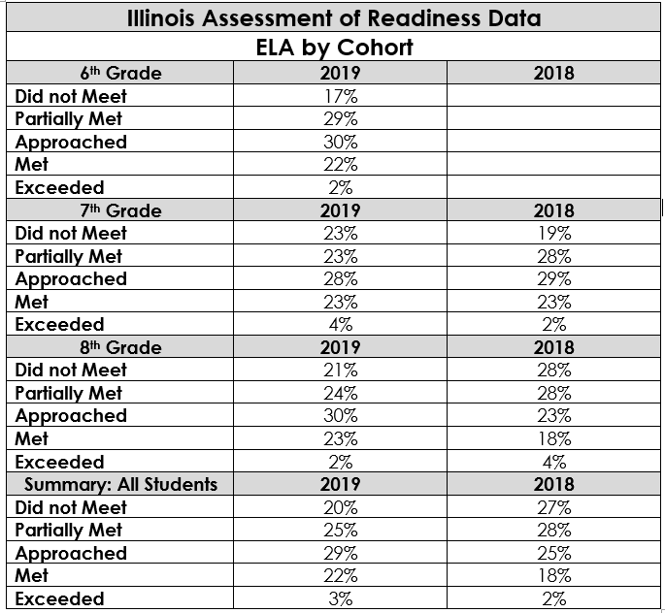
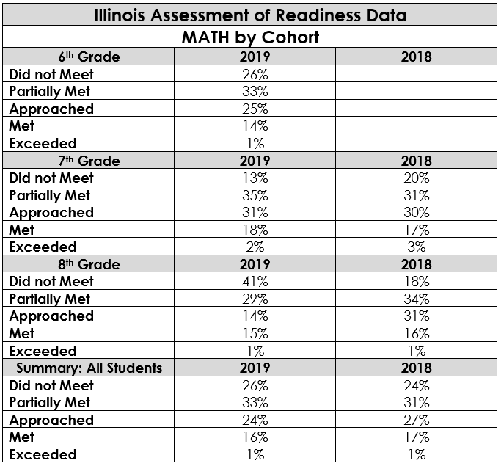
goals
QJHS will increase the number of students meeting and exceeding on IAR by 2%.

Slide 7
Student growth
# of Student Goals/ # of Students Reached Goal- 9974 goals/7517 reached goal=75.37%
Average Teacher SLO met Objectives: 45/50 teachers met objective=98%
Number of Student Referrals for the 17-18 School Year: 3877 Referrals (605 students)
Number of Student Referrals for the 18-19 School Year: 4239 Referrals (639 students)
Overall Attendance for the 17-18 School Year: 92.69%
Overall Attendance for the 18-19 School Year: 8-23-18-5-31-19=92.54%

Slide 8
Hot rocks
QJHS is currently working with the ROE and a Learning Partner to help teachers better understand quality assessments and backwards design. By strengthening the curriculum already in place and creating learning tasks that are rigorous and relevant, QJHS is hopeful that it will see an increase in student achievement not only in MAP but on the Illinois Assessment of Readiness.
QJHS will focus PD on the aforementioned during our Wednesday PLC time.
QJHS will continue to focus on Social Emotional Learning and Classroom Management as it pertains to adolescent development, trauma, poverty, and culture.
QJHS will increase technology to help support MTSS and the instructional needs of students.

