Slide 1
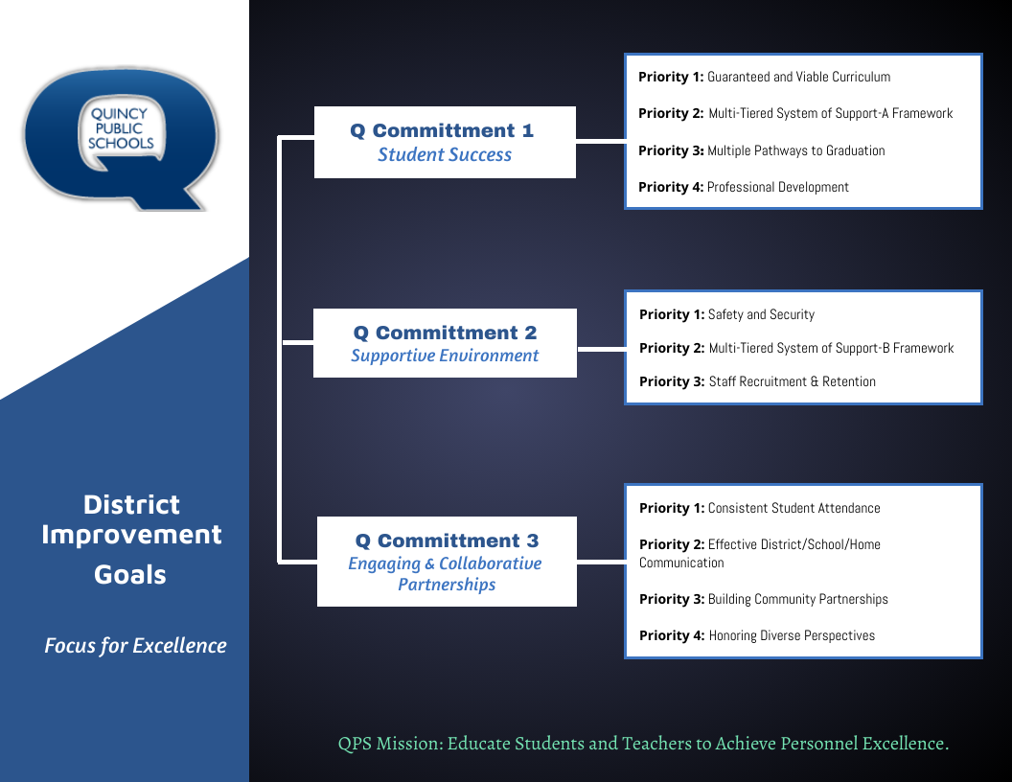

Slide 2
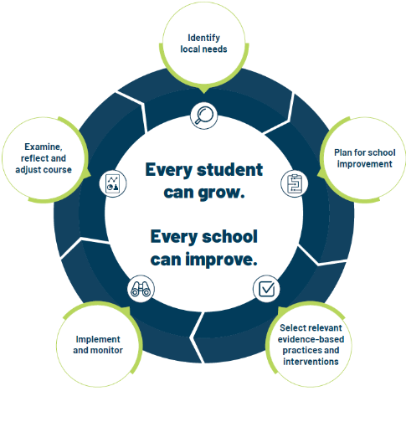
School Improvement Planning Process
Aligned to District Improvement Plan. (on-going)
Continuous and collaborative process.
Reviewed annually, monitored throughout the year- QPS uses three check-in cycles- Fall, Winter, Spring.
Plan identifies strengths and weaknesses in school level systems. Staff uses the information to making deliberate, positive, cohesive, and observable changes.
Unique to each schools needs while staying in line with District Commitment Goals/Improvement Plan.

Slide 3
Q Commitment Goal 1 STUDENT SUCCESS | Priority 1: Guaranteed and viable curriculum Clear expectations in all content areas so all students have an equal opportunity to learn essential content and skills identified for each grade level and course.
 | Priority 2: Multi-tiered System of Support Framework Responsive to student learning needs through intervention, strategies, and supports.
 | Priority 3: Multiple Pathways to Graduation Reflecting opportunities for success in college and/or the workforce upon graduation.
 | Priority 4: Professional Development Targeted professional learning for staff aligned to best practice to ensure equitable access to high quality instruction for students.
Q Commitment Goal 1: Guiding Question(s) for SIP
Who is demonstrating success in our school? Who is not?
What does the data tell us about our progress toward student success and areas of concern?
What does the data tell us about our progress toward Q Goal 1success?
What are staff needs of staff and what supports are needed for Q Goal 1 success?

Slide 4

QUINCY JUNIOR HIGH SCHOOL -- SCHOOL IMPROVEMENT PLAN- 2024-2025
Q COMMITTMENT GOAL 1: STUDENT SUCCESS
ENGLISH LANGUAGE ARTS (ELA) |  | By June 2025, students will increase academic growth and/or achievement on NWEA Growth Assessment (Reading).
MATHEMATICS |  | By June 2025, students will increase academic growth and/or achievement on NWEA Growth Assessment (Math).
MEASURES OF SUCCESS (Data/Progress Monitoring)
NWEA MAP- ELA/MATH Grade Report- Fall, Winter, Spring Hi Avg and Hi >60th percentile MAP School Profile Report- Fall, Winter, Spring |  | Progress Monitoring: Review MAP Grade Report- Fall, Winter, Spring Hi Avg and Hi >60th percentile | PLC & RTI TEAM MEETING NOTES & REFLECTIONS Data analysis protocol | COMMON ASSESSMENTS- ELA/MATH Data analysis protocol | STAFF SURVEY-COLLECTIVE TEACHER BELIEFS Pre/Post ACL WALKTHROUGHS Fall, Winter, Spring | Progress Monitoring: Review MAP Grade Report- Fall, Winter, Spring Hi Avg and Hi >60th percentile
SCHOOL LEVEL STRATEGIES (Actions/Tasks)
PROFESSIONAL DEVELOPMENT | Classroom teachers will engage in continued professional learning provided by ACLs regarding teacher credibility, collective efficacy, and standards-aligned curriculum.
INSTRUCTIONAL PRACTICE | Classroom teachers will engage in professional and crucial conversations within PLC and departments around curriculum mapping/pacing, grading practices, and high-level instruction.
INSTRUCTIONAL PRACTICE | Continued implementation of Young Men Initiative (YMI)
INSTRUCTIONAL PRACTICE | Classroom teacher will prioritize goal setting for MAP testing with individuals and small groups of students. Administration will hold mini-assemblies by grade-level or grade-level teams to communicate a consistent message around the importance of MAP and to celebrate MAP growth and achievement.
INSTRUCTIONAL PRACTICE | Data analysis around MTSS academic needs of students; implementation of Math 180 (ME) and FELA with data checks three times a year.

Slide 5
Q Commitment Goal 2 SUPPORTIVE ENVIRONMENT | Priority 1: Safety & Security Clear expectations for school behavior and a systematic approach to student discipline so that all have an equal opportunity to learn, belong, and succeed.​ ​
 | Priority 2: Multi-tiered System of Support Responsive to student social and emotional needs through intervention, strategies and supports.​
 | Priority 3: Staff Recruitment & Retention A systematic approach that encourages staff support and professional growth while focusing on recruitment and retention of a highly qualified and diverse staff.
Q Commitment Goal 2: Guiding Question(s) for SIP
Who is thriving in our school? Who is not?
What does the data tell us about our progress toward supportive environment and areas of concern?
What does the data tell us about our progress toward Q Goal 2 success?
What are staff needs of staff and what supports are needed for Q Goal 2 success?

Slide 6
QUINCY JUNIOR HIGH SCHOOL -- SCHOOL IMPROVEMENT PLAN 2024-2025
Q COMMITMENT GOAL 2: SUPPORTIVE ENVIRONMENT
STUDENT DISCIPLINE |  | By June 1, 2025, 85% of QPS students will be on track in school discipline (on track = behavior incidents on 2% or less of school days attended.)​ ​ *2023-2024 students on track discipline- District = 80% *2023-2024- students on track discipline- QJHS= 62%
MEASURES OF SUCCESS (Data/Progress Monitoring)
SKYWARD DISCIPLINE DATA Referrals by incident Total number ODRs OSS/ISS Days |  |  | PANORAMA BEHAVIOR DATA Critical and At-Risk Behavior Data- Monthly Intervention Data | SEL INTERVENTION DATA Monthly, Quarterly | STAFF DISCIPLINE SURVEY Fall- Winter- Spring
SCHOOL LEVEL STRATEGIES (Actions/Tasks)
INSTRUCTIONAL PRACTICE/MTSS | PBIS Systems, including boosters targeting “adult” behaviors | PBIS Systems, including boosters targeting “adult” behaviors
INSTRUCTIONAL PRACTICE/MTSS | Analyze data at the Tier 2 level for placement into appropriate intervention(s) and progress monitor for success; create new plan if not successful | Analyze data at the Tier 2 level for placement into appropriate intervention(s) and progress monitor for success; create new plan if not successful
INSTRUCTIONAL PRACTICE | Develop opportunities for student belonging through school based, teacher-led clubs | Develop opportunities for student belonging through school based, teacher-led clubs
PROFESSIONAL DEVELOPMENT | Classroom teachers, support staff and paraeducators will engage in five professional development sessions to build capacity around restorative practices in classrooms and schools. Introduction to RP, Proactive Community Building with Circles, The Social Discipline Window, Affective and Non-Judgmental Language, Restorative Chats and Mediation | Classroom teachers, support staff and paraeducators will engage in five professional development sessions to build capacity around restorative practices in classrooms and schools. Introduction to RP, Proactive Community Building with Circles, The Social Discipline Window, Affective and Non-Judgmental Language, Restorative Chats and Mediation
PROFESSIONAL DEVELOPMENT | School staff will continue building capacity around trauma informed practices in the classroom, specifically connected to classroom management strategies and engage in SEL cycles by the Instructional SEL coach as needed | School staff will continue building capacity around trauma informed practices in the classroom, specifically connected to classroom management strategies and engage in SEL cycles by the Instructional SEL coach as needed

Slide 7
Q Commitment Goal 3 ENGAGING AND COLLABORATIVE PARTNERSHIPS | Priority 1: ​Consistent Student Attendance Focus on the benefits of regular school attendance and links to student long term success.
 | Priority 2: Effective District/School/Home Communication Ensure parents, students, and families have consistent communication regarding district and school information and clear points of contact when questions arise.
 | Priority 3: Building Community Partnerships Collaborate with local community organizations to expand opportunities for all students.
 | Priority 4: Honoring Diverse Perspectives Recognize the diversity within our schools and community and ensure all voices are represented and heard.
Q Commitment Goal 3: Guiding Question(s) for SIP
Who is connected at our school? Who is not?
What does the data tell us about our progress toward engaging and collaborative partnerships and areas of concern?
What does the data tell us about our progress toward Q Goal 3 success?
What are staff needs of staff and what supports are needed for Q Goal 3 success?

Slide 8
QUINCY JUNIOR HIGH SCHOOL -- SCHOOL IMPROVEMENT PLAN 2024-2025
Q GOAL 3: ENGAGING AND COLLABORATIVE PARTNERSHIPS
STUDENT ATTENDANCE | BY June 1, 2025, 80% of QPS students will be on track in school attendance (on track = attending school 90% of time or more) *2023-2024 students on track in school attendance- District= 71% *2023-2024 students on track in school attendance- QJHS= 66%
Q GOAL 3 Measures of Success (Data/Progress Monitoring)
SKYWARD ATTENDANCE DATA Students at 90% or above Students below 90% attendance 9 or more absences |  | PARENT EVENT ATTENDANCE DATA Number of parents/families per event | 5ESSENTIALS PARENT SURVEY DATA Supportive Environment Ambitious Instruction Informed Families | COMMUNITY ENGAGEMENTS Total number of opportunities per month/quarter/semester
Q GOAL 3 SCHOOL LEVEL STRATEGIES (Actions/Tasks)
FAMILY/COMMUNITY ENGAGEMENT | Host Parent Academies to keep parents informed about current issues with middle schoolers Increase parent volunteer opportunities (special event supervision, classroom helpers, labs/presentations, etc.)​ or community speakers Continued partnerships with colleges/universities, mentors, YoungLife, Thriving Minds, PTO, Art Center, etc. |  | Enhance current parent engagement activities
MTSS- INTERVENTION/SUPPORTS | Schedule attendance action planning meetings for students who are not attending school regularly. Partner with ROE and/or other community organizations to enhance support for action planning with families. |  | Opportunities for parents to engage in their child’s academic at school and at home.
PARENT COMMUNICATION | Parent outreach communication (via school social media sites, Skyward, etc.) outlining the importance of school attendance using current research. Weekly parent communication sent to parents regarding curriculum and upcoming events by RtI teams and/or singleton teachers.
INSTRUCTIONAL PRACTICE | Develop opportunities for student belonging through school based, teacher-led clubs

