Slide 1

Quincy Junior High School IMPROVEMENT PLAN
School Improvement Plan 2025-2026
QPS Board of Education Reviewed and Approved
6/25/2025

Slide 2
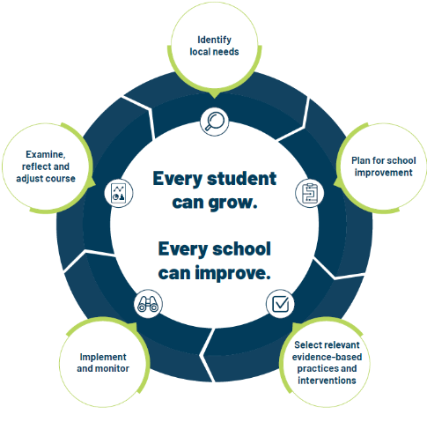
School Improvement Planning Process
Aligned to District Improvement Goals. (on-going)
Continuous and collaborative process.
Reviewed annually, monitored throughout the year- QPS uses quarterly check-in cycles.
Plan identifies strengths and weaknesses in school level systems. Staff uses the information to making deliberate, positive, cohesive, and observable changes.
Unique to each schools needs while staying in line with District Goals/Strategic Plan

Slide 3
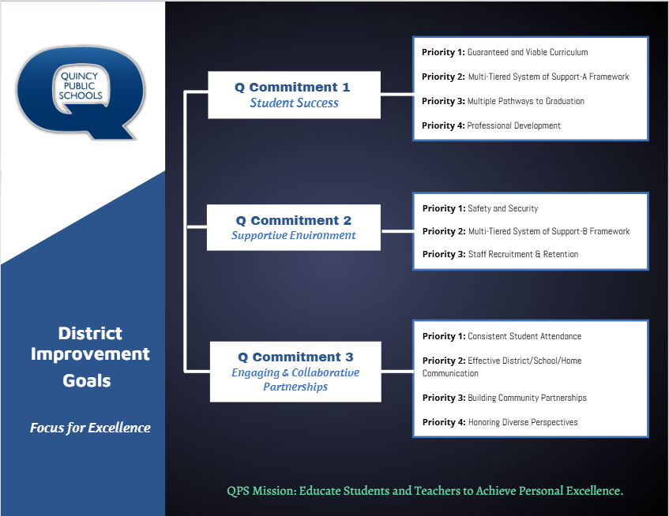

Slide 4
Q Commitment Goal 1 STUDENT SUCCESS | Priority 1: Guaranteed and viable curriculum Clear expectations in all content areas so all students have an equal opportunity to learn essential content and skills identified for each grade level and course.
 | Priority 2: Multi-tiered System of Support Framework Responsive to student learning needs through intervention, strategies, and supports.
 | Priority 3: Multiple Pathways to Graduation Reflecting opportunities for success in college and/or the workforce upon graduation.
 | Priority 4: Professional Development Targeted professional learning for staff aligned to best practice to ensure equitable access to high quality instruction for students.
Q Commitment Goal 1: Guiding Question(s) for SIP
Who is demonstrating success in our school? Who is not?
What does the data tell us about our progress toward student success and areas of concern?
What does the data tell us about our progress toward Q Goal 1success?
What are the staff needs to achieve Q Commitment Goal 1 success? (Consider: PD, systems alignment, staff alignment, etc.)

Slide 5
Quincy Junior High School– SCHOOL IMPROVEMENT PLAN 2025-2026
Q COMMITMENT GOAL 1: STUDENT SUCCESS
LITERACY | By June 1, 2026, students will increase academic growth and/or achievement on NWEA Growth Assessment (Reading) based on Fall 2025 to Spring 2026 data.
MATH | By June 1, 2026, students will increase academic growth and/or achievement on NWEA Growth Assessment (Math) based on Fall 2025 to Spring 2026 data.
MEASURES OF SUCCESS (Data/Progress Monitoring)
NWEA MAP- ELA/MATH Grade Report- Fall, Winter, Spring Hi Avg and Hi >60th percentile MAP School Profile Report- Fall, Winter, Spring COMMON ASSESSMENTS- ELA/MATH/SCI/SS Data analysis protocol |  | PLC & RTI TEAM MEETING NOTES & REFLECTIONS Data analysis protocol MTSS Leadership Team Progress tracking, support planning, family involvement PANORAMA DATA Awards ceremony- increase subgroup % Academic , attendance, behavior data Improved student performance on common and benchmark assessments | STAFF SURVEY-COLLECTIVE TEACHER BELIEFS Pre/Post LEARNING WALKS Increased teacher confidence & craft Consistent use of high-impact practices schoolwide Opportunities for ongoing, job-embedded PD 5-ESSENTIALS- Increased stakeholder perception in: Rigorous Expectations (student) Teacher-Student Relationships (student) Sense of Belonging (student) Professional Learning (teacher) School Fit (family)
SCHOOL LEVEL STRATEGIES (Actions/Tasks)
Guaranteed and Viable Curriculum | Use PLCs to collaboratively plan instruction, analyze student work, and respond to learning needs Utilize established pacing guides that specify the timeframe for each unit and standard, with opportunities to allow for reteaching and differentiation. Include essential vocabulary, assessments, and suggested instructional strategies. Embed common formative assessments for each unit and use data to identify mastery levels and gaps
MTSS Pathways | School staff members will implement our schoolwide MTSS framework integrating academic, behavioral, and social-emotional supports utilizing data teams & training to identify students, implement plans and monitor progress towards goals. Provide high-quality core instruction that is differentiated, standards-aligned and culturally responsive.
Professional Development | Classroom teachers will engage in targeted, ongoing, and equity-focused professional development within PLC/departments through a tiered plan based on staff need. Focus areas: Guaranteed viable curriculum, & assessment, culturally responsive teaching, differentiated instruction, high-level instructional practices, and student engagement. Build staff capacity to deliver effective Tier 1 and 2 supports (differentiation, scaffolding, behavior de-escalation, restorative practices, data analysis for progress monitoring. Learning walks with new teachers, teacher residents, ACLs

Slide 6
Q Commitment Goal 2 SUPPORTIVE ENVIRONMENT | Priority 1: Safety & Security Clear expectations for school behavior and a systematic approach to student discipline so that all have an equal opportunity to learn, belong, and succeed.​ ​
 | Priority 2: Multi-tiered System of Support Responsive to student social and emotional needs through intervention, strategies and supports.​
 | Priority 3: Staff Recruitment & Retention A systematic approach that encourages staff support and professional growth while focusing on recruitment and retention of a highly qualified and diverse staff.
Q Commitment Goal 2: Guiding Question(s) for SIP
Who is thriving in our school? Who is not?
What does the data tell us about our progress toward supportive environment and areas of concern?
What does the data tell us about our progress toward Q Goal 2 success?
What are the needs of our staff to achieve Q Commitment Goal 2 success? (Consider: PD, systems alignment, staff alignment, etc.)

Slide 7
QJHS SCHOOL IMPROVEMENT PLAN 2025-2026
Q GOAL 2: SUPPORTIVE ENVIRONMENT |  |  |  |  |  | District Q Goal 2
STUDENT DISCIPLINE |  | By June 1, 2026, 75% of QJHS students will be on track in behavior. (2024-2025 students on track behavior =68%) ​ ​ ​ *On Track = behavior incidents on 2% or less of school days attended​ *District Goal: By June 1, 2026, 85% of QPS students will be on track
Q GOAL 2 Measures of Success (Data/Progress Monitoring)
SKYWARD DISCIPLINE DATA Referrals by incident Total number ODRs OSS/ISS Days |  |  | PANORAMA BEHAVIOR DATA Critical and At-Risk Behavior Data- Monthly Intervention Data | SEL INTERVENTION DATA Monthly, Quarterly | STAFF DISCIPLINE SURVEY Fall- Winter- Spring 5-ESSENTIALS- Increased stakeholder perception in: Staff -Leadership relationships (teacher) Belonging (teacher) Climate (teacher) School safety (student)
Q GOAL 2 SCHOOL LEVEL STRATEGIES (Actions/Tasks)
INSTRUCTIONAL PRACTICE/MTSS | PBIS Systems, including boosters targeting “adult” behaviors Monthly grade/team level celebrations, recognition opportunities | PBIS Systems, including boosters targeting “adult” behaviors
INSTRUCTIONAL PRACTICE/MTSS | Analyze data at the Tier 2 level for placement into appropriate intervention(s) and progress monitor for success; create new plan if not successful | Analyze data at the Tier 2 level for placement into appropriate intervention(s) and progress monitor for success; create new plan if not successful
INSTRUCTIONAL PRACTICE | Develop opportunities for student belonging through school based, teacher-led clubs/groups, Comet Hour, Comet Connections (extended day & summer learning). Establish Student Focus groups to promote inclusive decision making. | Develop opportunities for student belonging through school based, teacher-led clubs
PROFESSIONAL DEVELOPMENT | Classroom teachers, support staff and paraeducators will expand upon restorative practices in classrooms and schools. Improve teacher retention by fostering a culture of care and well-being through a dedicated Wellness Team. (Comet Companions, staff shoutouts, morale boosters) | Classroom teachers, support staff and paraeducators will engage in five professional development sessions to build capacity around restorative practices in classrooms and schools. Introduction to RP, Proactive Community Building with Circles, The Social Discipline Window, Affective and Non-Judgmental Language, Restorative Chats and Mediation
PROFESSIONAL DEVELOPMENT | School staff will continue building capacity around trauma informed practices in the classroom, specifically connected to classroom management strategies and engage in SEL cycles by the Instructional SEL coach as needed | School staff will continue building capacity around trauma informed practices in the classroom, specifically connected to classroom management strategies and engage in SEL cycles by the Instructional SEL coach as needed

Slide 8
Q Commitment Goal 3 ENGAGING AND COLLABORATIVE PARTNERSHIPS | Priority 1: ​Consistent Student Attendance Focus on the benefits of regular school attendance and links to student long term success.
 | Priority 2: Effective District/School/Home Communication Ensure parents, students, and families have consistent communication regarding district and school information and clear points of contact when questions arise.
 | Priority 3: Building Community Partnerships Collaborate with local community organizations to expand opportunities for all students.
 | Priority 4: Honoring Diverse Perspectives Recognize the diversity within our schools and community and ensure all voices are represented and heard.
Q Commitment Goal 3: Guiding Question(s) for SIP
Who is connected at our school? Who is not?
What does the data tell us about our progress toward engaging and collaborative partnerships and areas of concern?
What does the data tell us about our progress toward Q Goal 3 success?
What are the needs of our staff to achieve Q Commitment Goal 3 success? (Consider: PD, systems alignment, staff alignment, etc.)

Slide 9
QJHS SCHOOL IMPROVEMENT PLAN 2025-2026
Q GOAL 3: ENGAGING AND COLLABORATIVE PARTNERSHIPS |  |  |  |  | District Q Goal 3
STUDENT ATTENDANCE | By June 1, 2026, the YTD number of QJHS students “on track” or better in attendance will increase to: -7th grade: 320 students -School-wide: 1000 students ​ ​​ *On track = attending school 90% of the time or more.​ *QPS District Goal: By June 1, 2026, 80% of QPS students will be on track with student attendance
Q GOAL 3 Measures of Success (Data/Progress Monitoring)
SKYWARD ATTENDANCE DATA Students at 90% or above Students below 90% attendance 9 or more absences |  | PARENT EVENT ATTENDANCE DATA Number of parents/families per event | 5ESSENTIALS PARENT SURVEY DATA School Fit Family Engagement Barriers to Engagement | COMMUNITY ENGAGEMENTS Total number of opportunities per month/quarter/semester
Q GOAL 3 SCHOOL LEVEL STRATEGIES (Actions/Tasks)
FAMILY/COMMUNITY ENGAGEMENT | Host Parent Academies to keep parents informed about current issues with middle schoolers Increase parent volunteer opportunities (special event supervision, classroom helpers, labs/presentations, etc.)​ or community speakers Continued partnerships with colleges/universities, mentors, YoungLife, Thriving Minds, PTO, Art Center, etc. Establish Family & Community Advisory groups to foster inclusive decision making and build connection |  | Enhance current parent engagement activities
MTSS- INTERVENTION/SUPPORTS | Schedule attendance action planning meetings for students who are not attending school regularly. Partner with ROE and/or other community organizations to enhance support for action planning with families. |  | Opportunities for parents to engage in their child’s academic at school and at home.
PARENT COMMUNICATION | Parent outreach communication (via school social media sites, Skyward, etc.) outlining the importance of school attendance using current research. Weekly parent communication sent to parents regarding curriculum and upcoming events by teams, clubs, and/or program coordinators Quarterly school newsletters that highlight student success, progress, and opportunities for growth.
INSTRUCTIONAL PRACTICE | Develop opportunities for student belonging through community organizations & partnerships Young Men Initiative (YMI), YWI, PLCs, teaming , Comet Connections, Professional Learning, Student Council, Student Ambassadors, Comet Hour, etc.

