Slide 1

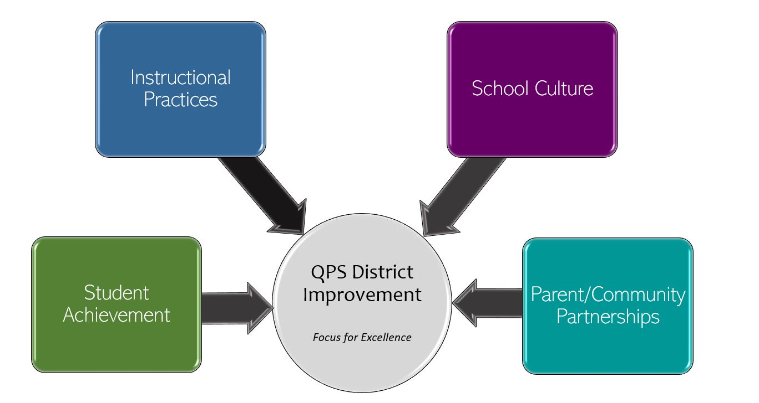
Quincy Junior High School-School Improvement 2022-2023 Focus for Excellence
Goal 1- Student Achievement | Alignment to District Q Goal 1
Reading QJHS will increase the percentage of students projected to meet and exceed in Reading on the Illinois Assessment of Readiness from 76.7% to 78.7% as measured by NWEA MAP Spring 2022 to Spring 2023 comparisons. Math QJHS will increase the percentage of students projected to meet and exceed in Math on the Illinois Assessment of Readiness from 53.7% to 55.7% as measured by NWEA MAP Spring 2022 to Spring 2023 comparisons. | QPS WILL increase student achievement and growth in grades PK-12. *Evidenced by: State and local assessment data and MTSS intervention data.
Evidenced by: (Data/Monitoring)
Monitoring will occur Fall, Winter, & Spring using the NWEA MAP Projected Proficiency Report.
School Tasks and Staff Professional Development to Support Goal
Staff will set goals with students Staff will share what the MAP data means to individual students PD will be provided to new staff regarding NWEA MAP reports and data to use for instructional purposes Development of QJHS Leadership Team with various stakeholders

Slide 2
Quincy Junior High School-School Improvement 2022-2023 Focus for Excellence
Goal 2- Instructional Practices | Alignment to District Q Goal 2
QJHS will increase the percentage of staff who perceive the amount and quality of professional growth and learning opportunities available from 32% to 42% as measured by the Panorama Staff Survey Spring to Spring comparisons. | QPS WILL utilize standards-based curriculum maps to ensure a guaranteed and viable curriculum is provided for all students and work in professional learning communities to plan for instruction that promoted critical thinking, collaboration, creativity and engagement. *Evidenced by: 5Essentials Survey data, state and local assessment data, instructional practice data
Evidenced by: (Data/Monitoring)
Panorama Staff Survey (Fall, Winter, & Spring) PLC Agendas
School Tasks and Staff Professional Development to Support Goal
Needs assessment for Professional Development Professional Development will be differentiated to meet the needs of staff ACLs will bring back information from PK-12 Academic Team on instructional practices Development of QJHS Leadership Team with various stakeholders

Slide 3
Quincy Junior High School- School Improvement 2022-2023 Focus for Excellence
Goal 3- School Culture | Alignment to District Q Goal 3
QJHS will increase the overall social and learning climate of the school from 25% to 35%. as measured by the Panorama Staff Survey Spring to Spring comparisons. QJHS will decrease the number of ODRs and OSS by 25% (3860 ODRs in 2021-2022). | QPS WILL maintain and safe, healthy, supportive and equitable environment for all students and staff. *Evidenced by: School Culture Data, Discipline Data, MTSS data and Teacher Retention Rate
Evidenced by: (Data/Monitoring)
Panorama Staff Survey (Fall, Winter, & Spring) Skyward Data Review for ODRs & OSS weekly Tier 2 and Tier 3 Review Meetings Data accountability meetings with counselors, psych, social worker as well as with deans
School Tasks and Staff Professional Development to Support Goal
SSFL will continue to meet with students and set academic and behavioral goals, continue study squad, and other activities to increase equitable opportunities for subgroups Use of Panorama data for early intervention of students with behavior needs MTSS system followed with fidelity PBIS team continues work to bring awareness and data to forefront of staff Dean/Counselor/Team meetings weekly (first few weeks discussing how and when to write referrals, review of levels 1-5 and clarification of Tier 1, Dean/Counselor meetings with each color at each grade level first two weeks of school, Active Supervision clarification for staff) Development of QJHS Leadership Team with various stakeholders

Slide 4
Quincy Junior High School- School Improvement 2022-2023 Focus for Excellence
Goal 4- Parent/Community Partnerships | Alignment to District Q Goal 4
QJHS will strengthen parent support and community engagement by focusing on clear and frequent communication from school to home. Survey will be sent in the Fall to obtain baseline data. | QPS WILL strengthen parent support and community engagement by building positive relationships and communication between parents, families, schools and community to foster success for all students. *Evidenced by: Attendance and truancy data, parent event attendance, parent survey data, discipline data
Evidenced by: (Data/Monitoring)
Panorama Parent Survey (Fall, Winter, Spring)
School Tasks and Staff Professional Development to Support Goal
Team and individual teacher Skyward blast messages More frequent messages from the Principal/Administration (Skylert and Skyward messages) Continued use of Social Media Parent Orientation for incoming 6th grade students and transfer students Parent Academies (quarterly)

