Slide 1

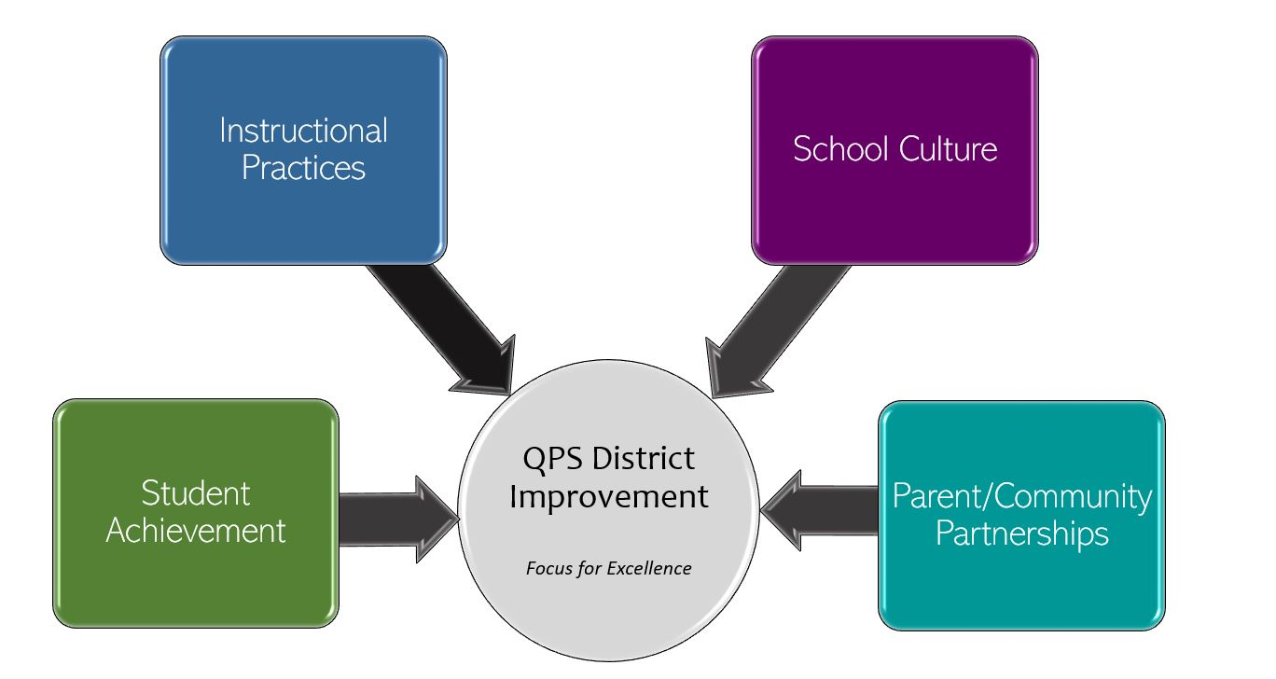
Quincy High School - School Improvement 2022-2023 Focus for Excellence
Goal 1- Student Achievement | Alignment to District Q Goal 1
At the end of 2022-23, 80% or more of students will be on track for Graduation. 9th Graders = 5-6 credits 10th Graders = 11-14 credits 11th Graders = 16-19 credits 12th Graders = 23+ credits | QPS WILL increase student achievement and growth in grades PK-12. *Evidenced by: State and local assessment data and MTSS intervention data.
Evidenced by: (Data/Monitoring)
Twice monthly data pulls to target support and measure progress. Excelling (Target = 20% or more) On track (Target = 50% or more) At Risk (Target = Less than 20%) Critical (Target = Less than 10%)
School Tasks and Staff Professional Development to Support Goal
Streamlined PLC teams focus on updated curriculum maps and common assessments. Professional Development to ensure equal access to curriculum and support. Implement a coordinated intervention process. Revamped Climate and Culture Team Incorporate core curriculum into CTE courses

Slide 2
Quincy High School - School Improvement 2022-2023 Focus for Excellence
Goal 2- Instructional Practices | Alignment to District Q Goal 2
In August 2022, a staff instructional survey will be administered in the areas of Teaching Environment, Educating All Students, and Perceptions of Teaching. Specific instructional practices goals will be set at that time. The survey will be given three times throughout the year. | QPS WILL utilize standards-based curriculum maps to ensure a guaranteed and viable curriculum is provided for all students and work in professional learning communities to plan for instruction that promoted critical thinking, collaboration, creativity and engagement. *Evidenced by: 5Essentials Survey data, state and local assessment data, instructional practice data
Evidenced by: (Data/Monitoring)
Instructional practices survey results Student surveys based on Five Essentials in English and Math – Ambitious Instruction (October, January, May) PLC team rubric – three times a year
School Tasks and Staff Professional Development to Support Goal
Renewed focus on PLC team collaboration Update curriculum maps to strengthen rigor, relevance, and alignment To be determined by survey results.

Slide 3
Quincy High School - School Improvement 2022-2023 Focus for Excellence
Goal 3- School Culture | Alignment to District Q Goal 3
In August 2022, a staff climate survey in the areas of Relative Responsibilities and School Climate will be administered. Specific climate and culture goals will be set at that time. The survey will be given three times throughout the year. | QPS WILL maintain and safe, healthy, supportive and equitable environment for all students and staff. *Evidenced by: School Culture Data, Discipline Data, MTSS data and Teacher Retention Rate
Evidenced by: (Data/Monitoring)
Twice monthly monitoring of Panorama data in the areas of Attendance and Discipline Discipline, OSS, and ISS data Monthly attendance rate Teacher retention rate
School Tasks and Staff Professional Development to Support Goal
Renewed focus on HELPs meetings Development of Climate and Culture Team Coordination of Intervention Restorative practices professional development for support staff Re-introduction of Social Committee

Slide 4
Quincy High School - School Improvement 2022-2023 Focus for Excellence
Goal 4- Parent/Community Partnerships | Alignment to District Q Goal 4
QHS will increase parent/family outreach and increase student attendance rate during the 2022-23 school year: 100% of families will receive at least one personal and specific contact from a QHS teacher Decrease by 5% the number of chronically truant students | QPS WILL strengthen parent support and community engagement by building positive relationships and communication between parents, families, schools and community to foster success for all students. *Evidenced by: Attendance and truancy data, parent event attendance data, parent survey data, discipline data
Evidenced by: (Data/Monitoring)
Twice monthly attendance check Monthly attendance reports Parent/family survey regarding QHS communication – three times a year Parent communication tracking tool
School Tasks and Staff Professional Development to Support Goal
Increased emphasis on HELPs meetings Implementation of Quarterly parent/family meetings Redesign protocol for chronically truant students Implementation of restorative practices for suspended students Reformat newsletter – sent quarterly to parents/families

