Slide 1
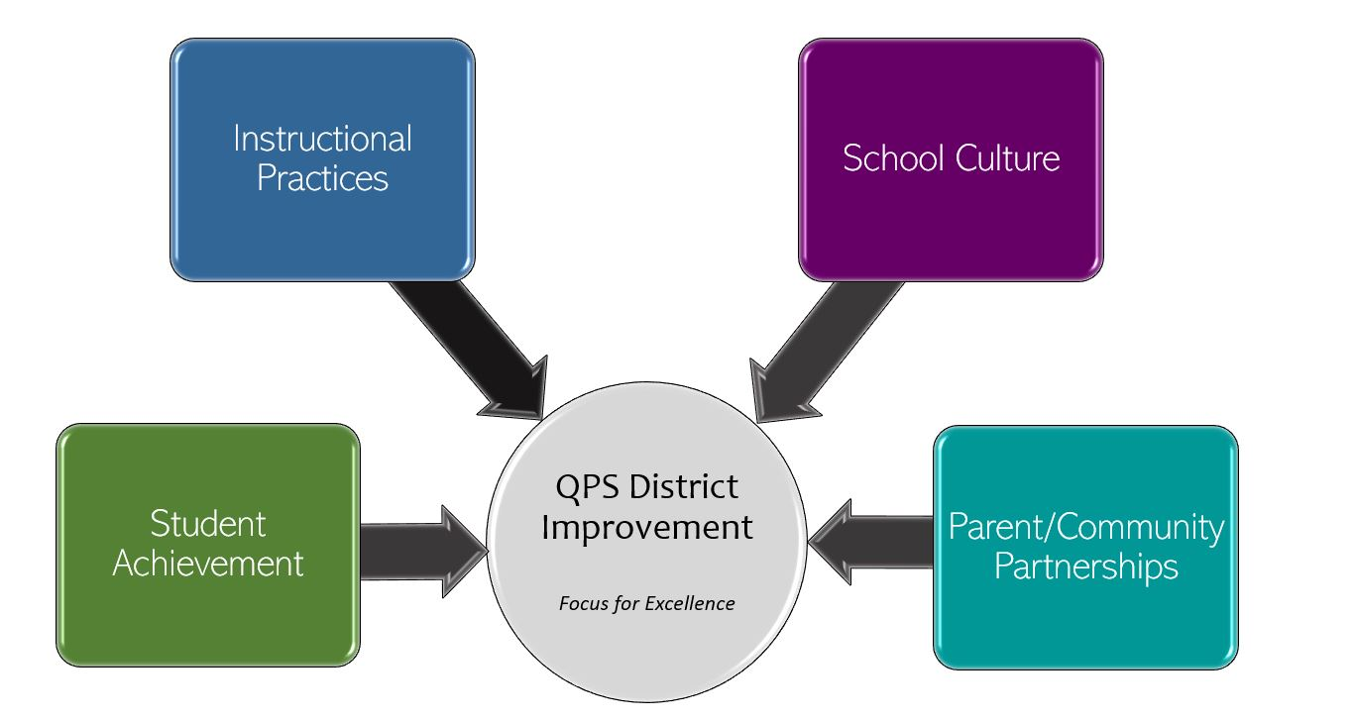
Rooney Elementary School Improvement 2022-2023 Focus for Excellence
Goal 1- Student Achievement | Alignment to District Q Goal 1
Rooney Elementary will increase MAP Reading Achievement from Fall 2022 to Spring 2023 in all grades. Rooney Elementary will increase MAP Math Achievement from Fall 2022 to Spring 2023 in all grades. Rooney Elementary will increase MAP Language Usage Achievement from Fall 2022 to Spring 2023 in all grades. | QPS WILL increase student achievement and growth in grades PK-12. *Evidenced by: State and local assessment data and MTSS intervention data.
Evidenced by: (Data/Monitoring)
F&P Assessment data Everyday Math Unit Assessment data Writing proficiency data Panorama MTSS data (grades) NWEA MAP Growth data
School Tasks and Staff Professional Development to Support Goal
Student Achievement Leadership Team monthly meetings Data review 3 times – October 2022, January 2023, May 2023 Staff professional development Vertical planning Curriculum review

Slide 2
Rooney Elementary School Improvement 2022-2023 Focus for Excellence
Goal 2- Instructional Practices | Alignment to District Q Goal 2
Rooney Elementary will increase student academic engagement by utilizing best practices that increase student motivation, promote critical thinking skills and develop growth mindset and resiliency in all students. | QPS WILL utilize standards-based curriculum maps to ensure a guaranteed and viable curriculum is provided for all students and work in professional learning communities to plan for instruction that promotes critical thinking, collaboration, creativity and engagement. *Evidenced by: School culture data, state and local assessment data, instructional practice data
Evidenced by: (Data/Monitoring)
Instructional Practice Inventory- observations Student/Staff Engagement survey/feedback 5Essentials Survey Data Teacher Peer Observations
School Tasks and Staff Professional Development to Support Goal
Student Engagement Leadership Team monthly meetings Data Review 3 times- October 2022, January 2023, May 2023 Staff Professional Development Curriculum review

Slide 3
Rooney Elementary School Improvement 2022-2023 Focus for Excellence
Goal 3- School Culture | Alignment to District Q Goal 3
Rooney Elementary will decrease office discipline referrals for disrespect by 10% from August 2022 to May 2023. | QPS WILL maintain and safe, healthy, supportive and equitable environment for all students and staff. *Evidenced by: School Culture Data, Discipline Data, Teacher Retention data and MTSS data
Evidenced by: (Data/Monitoring)
Panorama MTSS data ODRs- Skyward Discipline data Student/Staff Surveys Classroom observations
School Tasks and Staff Professional Development to Support Goal
School Culture Leadership Team monthly meetings to review discipline data and plan for universal MTSS Data Review 3 times – October 2022, January 2023, May 2023 Staff Professional Development (PBIS, Classroom Management, Social Emotional Learning) Rooney Student Grade Level Leadership Teams

Slide 4
Rooney Elementary School Improvement 2022-2023 Focus for Excellence
Goal 4- Parent/Community Partnerships | Alignment to District Q Goal 4
Rooney Elementary will increase the overall student average daily attendance by 5% for the 2022-2023 school year, by decreasing chronic absences, chronic tardiness and increasing parent involvement. *2021-2022 average daily attendance was 91.6%. | QPS WILL strengthen parent support and community engagement by building positive relationships and communication between parents, families, schools and community to foster success for all students. *Evidenced by: Attendance and truancy data, parent event attendance, parent survey data, discipline data
Evidenced by: (Data/Monitoring)
Panorama MTSS data Skyward discipline and attendance data Parent feedback/survey
School Tasks and Staff Professional Development to Support Goal
Parent Community Partnership Leadership Team monthly meetings Data review- 3 times- October 2022, January 2023, May 2023 Rooney PTO partnership- Community Involvement Team Parent Education Attendance acknowledgements and celebrations

