Slide 1
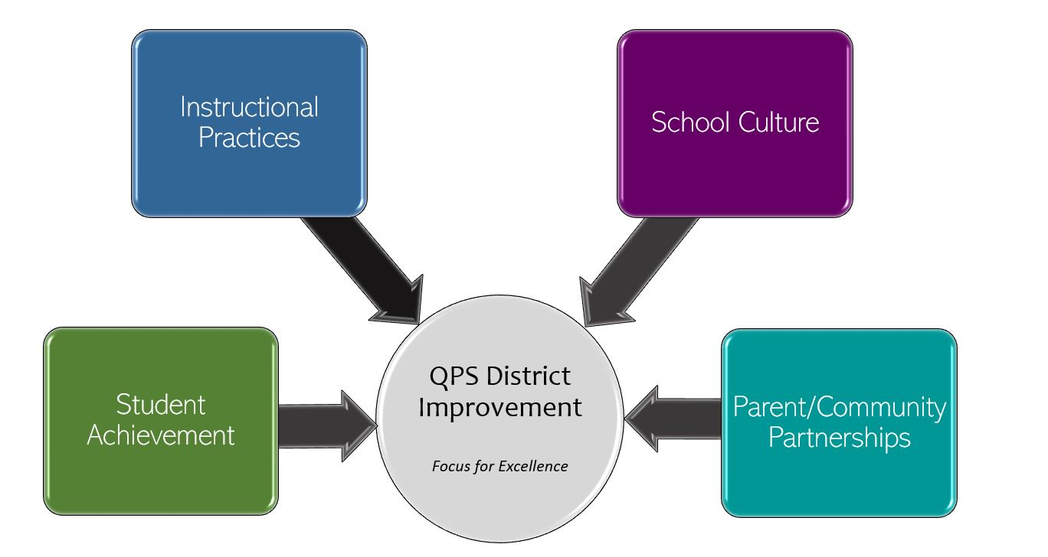
The Academy School Improvement 2022-2023 Focus for Excellence
Goal 1- Student Achievement | Alignment to District Q Goal 1
Increase student course completion. Quarter 1: Increase overall course completion to 70% | QPS WILL increase student achievement and growth in grades PK-12. *Evidenced by: State and local assessment data and MTSS intervention data.
Evidenced by: (Data/Monitoring)
Class completion with passing grade Students making adequate progress toward graduation requirements of home school
School Tasks and Staff Professional Development to Support Goal
On going train the trainer model from the ROE1, to support internal PD in the area of trauma informed instructional classrooms. Continued internal collaboration during common planning, team meetings, and PLC on blended learning classrooms. Internal instructional rounds and feedback sessions on current instructional practices. Bi-weekly administrative team progress monitoring, discussion, and feedback Student participation in weekly self-monitoring of Alternative Education Plan (AEP) growth and plan weekly goal
Notes:
Do we list previous quarter data to show why we have the specified % for our goal.
How do I address the mobility or do I?
Will use the 4th quarter and ending data from 2021-2022 to decide goal %

Slide 2
The Academy School Improvement 2022-2023 Focus for Excellence
Goal 2- Instructional Practices | Alignment to District Q Goal 2
Quarter 1: Increase student engagement by providing consistent and meaningful instructional strategies within the classroom setting | QPS WILL utilize standards-based curriculum maps to ensure a guaranteed and viable curriculum is provided for all students and work in professional learning communities to plan for instruction that promotes critical thinking, collaboration, creativity and engagement. Evidenced by: School culture data, state and local assessment data, instructional practice data
Evidenced by: (Data/Monitoring)
Increased student time on task (Edgenuity session logs/Teacher observations) Weekly Alternative Education Plan (AEP) conferences on progress monitoring data by students and teachers Bi-weekly SSFL team progress monitoring conferences and feedback Monthly Q2 Team progress monitoring, discussion, and feedback
School Tasks and Staff Professional Development to Support Goal
On going train the trainer model from the ROE1, to support internal PD in the area of trauma informed instructional classrooms. Continued internal collaboration during common planning, team meetings, and PLC on blended learning classrooms. Internal instructional rounds and feedback sessions on current instructional practices. Provide “connect time” during each class period Implementation of research-based brain breaks

Slide 3
The Academy School Improvement 2022-2023 Focus for Excellence
Goal 3- School Culture | Alignment to District Q Goal 3
Quarter 1: Increase overall student attendance to an average of 70% | QPS WILL maintain and safe, healthy, supportive and equitable environment for all students and staff. *Evidenced by: School Culture Data, Discipline Data, Teacher Retention data, and MTSS data
Evidenced by: (Data/Monitoring)
Track daily SEL lesson participation of each student during homeroom SSFL daily home connection for absent students SSFL weekly home visits for truant students Monthly MTSS discipline data review and collaboration Monthly Q3 Team progress monitoring, discussion, and feedback Quarterly school culture data survey
School Tasks and Staff Professional Development to Support Goal
On going train the trainer model from the ROE1, to support internal PD in the area of trauma informed instructional classrooms. Continued internal collaboration during common planning, team meetings, and PLC on creating an environment of regulate, relate, and reason. Internal climate walk-through rounds and feedback sessions on current culture. Professional development for staff to strengthen restorative classroom practice Quarterly all school presentation, discussion, and feedback

Slide 4
The Academy-School Improvement 2022-2023 Focus for Excellence
Goal 4- Parent/Community Partnerships | Alignment to District Q Goal 4
Quarter 1: Increase positive parent communication between school and home. | QPS WILL strengthen parent support and community engagement by building positive relationships and communication between parents, families, schools and community to foster success for all students. Evidenced by: Attendance and truancy data, parent event attendance, parent survey data, discipline data
Evidenced by: (Data/Monitoring)
Logging number of contacts and topics of discussion Parent participation rate in family activities
School Tasks and Staff Professional Development to Support Goal
Teacher daily home connection for 1 student (call or in person) SSFL daily home connection for 1 student (call or in person) All staff weekly home connection for 2 students (notecard or email) Develop and communicate a monthly school newsletter sharing celebrations, current events, and data with students and families. Schedule and plan a quarterly parent/family activity

