Slide 1
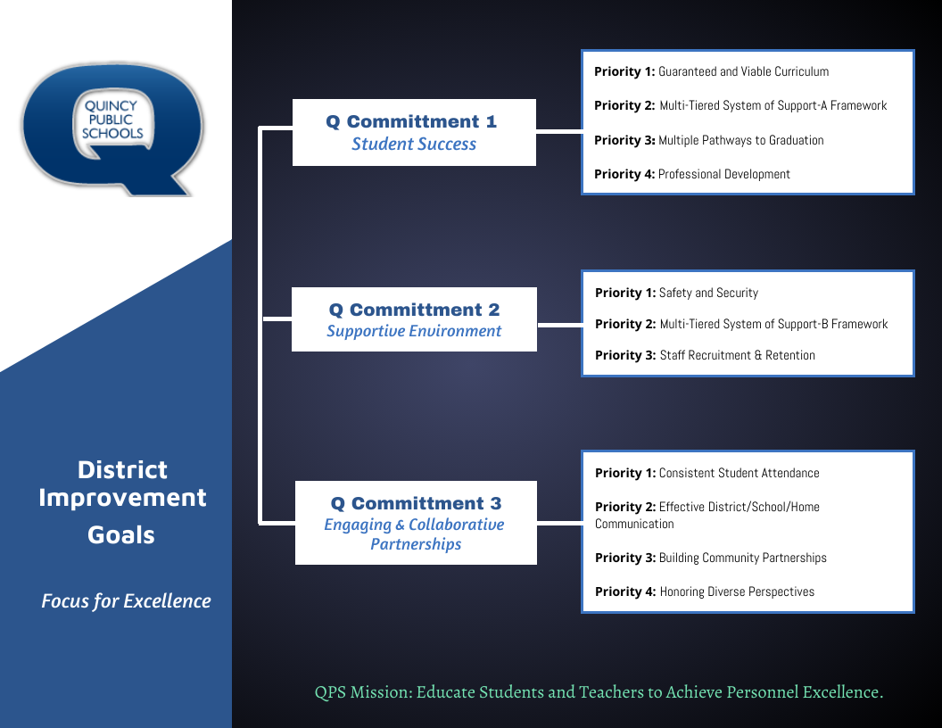

Slide 2
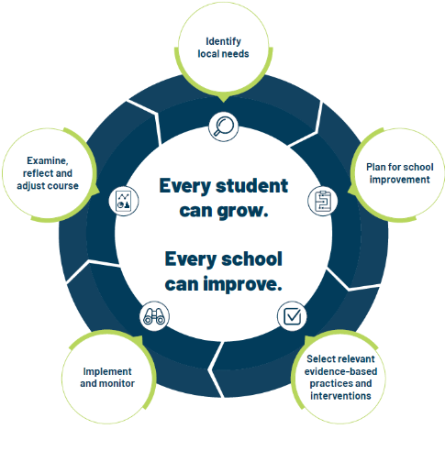
School Improvement Planning Process
Aligned to District Improvement Plan. (on-going)
Continuous and collaborative process.
Reviewed annually, monitored throughout the year- QPS uses three check-in cycles- Fall, Winter, Spring.
Plan identifies strengths and weaknesses in school level systems. Staff uses the information to making deliberate, positive, cohesive, and observable changes.
Unique to each schools needs while staying in line with District Commitment Goals/Improvement Plan.

Slide 3
Q Commitment Goal 1 STUDENT SUCCESS | Priority 1: Guaranteed and viable curriculum Clear expectations in all content areas so all students have an equal opportunity to learn essential content and skills identified for each grade level and course.
 | Priority 2: Multi-tiered System of Support Framework Responsive to student learning needs through intervention, strategies, and supports.
 | Priority 3: Multiple Pathways to Graduation Reflecting opportunities for success in college and/or the workforce upon graduation.
 | Priority 4: Professional Development Targeted professional learning for staff aligned to best practice to ensure equitable access to high quality instruction for students.
Q Commitment Goal 1: Guiding Question(s) for SIP
Who is demonstrating success in our school? Who is not?
What does the data tell us about our progress toward student success and areas of concern?
What does the data tell us about our progress toward Q Goal 1success?
What are staff needs of staff and what supports are needed for Q Goal 1 success?

Slide 4

THE ACADEMY – SCHOOL IMPROVEMENT PLAN 2024-2025
Q COMMITMENT GOAL 1: STUDENT SUCCESS
ACADEMICS | The Academy will increase the percentage of students meeting or exceeding their Alternate Education Plan (AEP) in the area of academics (Goal 1) by overall class completion of 80%.
MEASURES OF SUCCESS (Data/Progress Monitoring)
QUARTERLY AEP ACADEMIC DATA (GOAL 1) Classroom assessments-Overall class completion rates |  |  | INSTRUCTIONAL FIDELITY CHECKS Bi-weekly walkthrough form
Q GOAL 1 SCHOOL LEVEL STRATEGIES (Actions/Tasks)
INSTRUCTIONAL PLANNING |  | Staff/student daily written progress monitor conferences during CICO each period. |  | Staff/student daily written progress monitor conferences during CICO each period.
INSTRUCTIONAL PLANNING |  | Student weekly progress monitor written conference with homeroom teacher |  | Student weekly progress monitor written conference with homeroom teacher
INSTRUCTIONAL PLANNING |  | Student weekly progress monitor review conference with SSFL |  | Student weekly progress monitor review conference with SSFL
INSTRUCTIONAL PLANNING |  | Student bi-weekly progress monitor review conference with administration |  | Student bi-weekly progress monitor review conference with administration
INSTRUCTIONAL PRACTICE |  | Universal implementation of Edgenuity and teacher-led curriculum, with fidelity. |  | Universal implementation of Edgenuity and teacher led curriculum with fidelity.

Slide 5
Q Commitment Goal 2 SUPPORTIVE ENVIRONMENT | Priority 1: Safety & Security Clear expectations for school behavior and a systematic approach to student discipline so that all have an equal opportunity to learn, belong, and succeed.​ ​
 | Priority 2: Multi-tiered System of Support Responsive to student social and emotional needs through intervention, strategies and supports.​
 | Priority 3: Staff Recruitment & Retention A systematic approach that encourages staff support and professional growth while focusing on recruitment and retention of a highly qualified and diverse staff.
Q Commitment Goal 2: Guiding Question(s) for SIP
Who is thriving in our school? Who is not?
What does the data tell us about our progress toward supportive environment and areas of concern?
What does the data tell us about our progress toward Q Goal 2 success?
What are staff needs of staff and what supports are needed for Q Goal 2 success?

Slide 6
THE ACADEMY – SCHOOL IMPROVEMENT PLAN 2024-2025
Q GOAL 2: SUPPORTIVE ENVIRONMENT
STUDENT DISCIPLINE | By June 1, 2025, The Academy will decrease the percentage of office discipline referrals (ODR's) and out of school suspensions (OSS's) to meet or exceed their Alternate Education Plan (AEP) in the area of behavior (AEP Goal 3). |  | By June 1, 2025, The Academy will decrease the percentage of office discipline referrals (ODR's) and out of school suspensions (OSS's) to meet or exceed their Alternate Education Plan (AEP) in the area of behavior (AEP Goal 3).
MEASURE OF SUCCESS (Data/Progress Monitoring)
AEP BEHAVIOR DATA (GOAL 3) Office Discipline Referrals (ODR's) Out of Schoo Suspensions (OSS's) |  |  | MTSS DATA Social Emotional Behavior Groups (SEB1 & SEB2) | WALKTHROUGH DATA Bi-weekly walkthrough form | STAFF PD IMPLEMENTATION Weekly, Monthly during PLC | PARENT/GUARDIAN CONTACT DATA Monthly |  | RESTORATIVE/RE-ENTRY DATA Individualized per incident
SCHOOL LEVEL STRATEGIES (Actions/Tasks)
INSTRUCTIONAL PRACTICE |  | Support staff & administration will conduct bi-weekly climate walkthroughs to observe the implementation of universal school expectations
PROFESSIONAL DEVELOPMENT |  | Staff training and implementation - 180 Days of Educational Neuroscience to support student SEL needs.
PROFESSIONAL PRACTICE |  | Implement a universal security entrance check-in to ensure safety for all.
PROFESSIONAL PRACTICE |  | Implement a universal entrance visual/verbal check in to ensure safety and security for all.
INSTRUCTIONAL PRACTICE |  | Universal implementation of Connect Circles at the beginning of each class period.
INSTRUCTIONAL PRACTICE |  | Universal availability and support staff/administration coaching of regulation areas and regulation strategies within the classroom.
PROFESSIONAL PRACTICE |  | Point of Incident personnel and support personnel will conduct parent contact conversations

Slide 7
Q Commitment Goal 3 ENGAGING AND COLLABORATIVE PARTNERSHIPS | Priority 1: ​Consistent Student Attendance Focus on the benefits of regular school attendance and links to student long term success.
 | Priority 2: Effective District/School/Home Communication Ensure parents, students, and families have consistent communication regarding district and school information and clear points of contact when questions arise.
 | Priority 3: Building Community Partnerships Collaborate with local community organizations to expand opportunities for all students.
 | Priority 4: Honoring Diverse Perspectives Recognize the diversity within our schools and community and ensure all voices are represented and heard.
Q Commitment Goal 3: Guiding Question(s) for SIP
Who is connected at our school? Who is not?
What does the data tell us about our progress toward engaging and collaborative partnerships and areas of concern?
What does the data tell us about our progress toward Q Goal 3 success?
What are staff needs of staff and what supports are needed for Q Goal 3 success?

Slide 8
THE ACADEMY – SCHOOL IMPROVEMENT PLAN 2024-2025
Q GOAL 3: ENGAGING AND COLLABORATIVE PARTNERSHIPS
STUDENT ATTENDANCE | By June 1, 2025, The Academy will increase the percentage of students meeting or exceeding their Alternate Education Plan (AEP) in the area of attendance (AEP Goal 2).
Q GOAL 3 Measures of Success (Data/Progress Monitoring)
SKYWARD ATTENDANCE DATA Student absences/reason code |  | ROE TRUANCY DATA Collected quarterly | PARENT/GUARDIAN CONTACT DATA Monthly | AEP DATA (Goal 2) Number of absences/truancy/tardy |  | PARENT EVENT ATTENDANCE Number of parents attending
Q GOAL 3 SCHOOL LEVEL STRATEGIES (Actions/Tasks)
COMMUNITY PARTNERSHIP | Monthly collaboration with the ROE Truancy Department, Adams County Juvenile Detention Center, Adams County and State Probation Department.
COMMUNITY PARTNERSHIP | Continue community partnership with Faith Christian Church
PROFESSIONAL PRACTICE | Staff will conduct positive parent/guardian phone calls and send post cards.
PARENT INVOLVMENT | Parent/Guardian participation in the development of student AEP (Alternate Education Plan)
PARENT INVOLVEMENT | Parent/Guardian participation in the intake process (eligibility for program and development of the AEP)
PARENT INVOLVEMENT | Parent invitations to participate in Back-to-School event and Parent- Teacher conferences.

